Slide 1

Intel Edge Insights Software rapid deployment of analytics Pipelines
Industrial Solutions Division, Intel

Slide 2
Legal Notices and Disclaimers
Intel technologies’ features and benefits depend on system configuration and may require enabled hardware, software or service activation. Performance varies depending on system configuration. No computer system can be absolutely secure. Check with your system manufacturer or retailer or learn more at www.intel.com.
This document contains information on products, services and/or processes in development. All information provided here is subject to change without notice. Contact your Intel representative to obtain the latest forecast, schedule, specifications and roadmaps.
Any forecasts of goods and services needed for Intel’s operations are provided for discussion purposes only. Intel will have no liability to make any purchase in connection with forecasts published in this document.
ARDUINO 101 and the ARDUINO infinity logo are trademarks or registered trademarks of Arduino, LLC.
Intel, the Intel logo, Intel Inside, the Intel Inside logo, OpenVINO, Intel Atom, Celeron, Intel Core, and Intel Movidius Myriad 2 are trademarks of Intel Corporation or its subsidiaries in the U.S. and/or other countries.
*Other names and brands may be claimed as the property of others.
Copyright 2018 Intel Corporation.
2

Slide 3
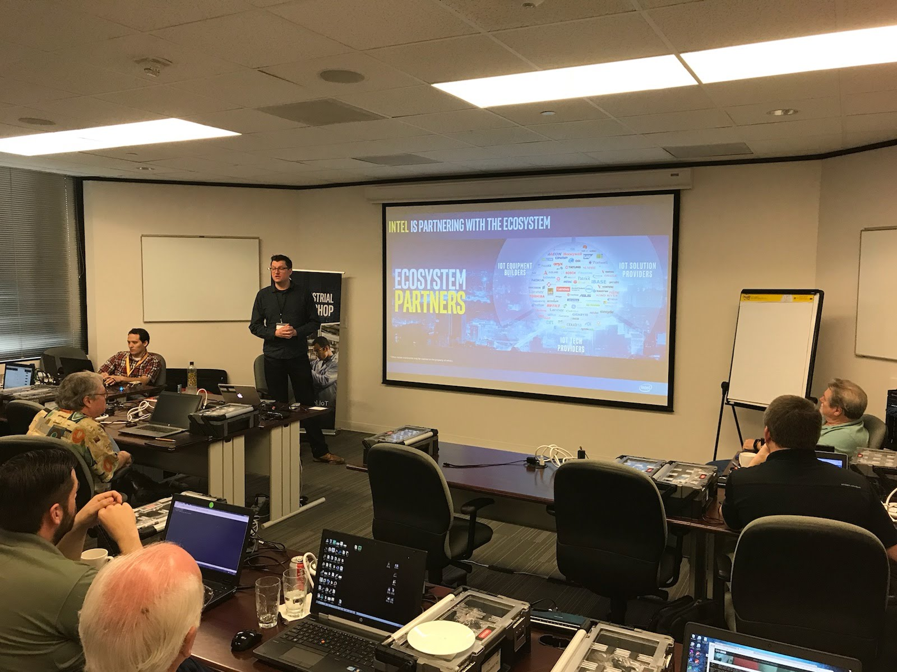
GE Edge & Control symposium Intel Edge Insights Software Workshop
Today’s Schedule
Intel Industrial Developer Program
Intel Vision for Industrial Workloads and Applications
Intel Computer Vision Deep Learning with OpenVINO*
Building and Deploying Visual Industrial Solutions on the Edge Insights Software Stack
Building and Deploying Time Series Industrial Solution on Edge Insights Software
Notes:
IIoT Workshop Overview
This presentation will start with an introduction to the Intel industrial development program.
Next we'll talk about Intel's vision for industrial applications and for workload consolidation. We'll also talk about how analytics is enabling new applications and streams of revenue.
OpenVino is a computer vision library based on deep learning and convolutional networks that can be used to enable video analytics applications on site.
The Intel Edge Insight Software stack provides a ready to deploy pipeline for data and video analytics applications. It removes the infrastructure software, data pipelines and metadata management, allowing you to focus on the application.

Slide 4

vision for Industrial IoT
McKinsey & Company
McKinsey & Company
Notes:
Intel is transforming from a PC company to a company that powers the cloud and billions of smart, connected computing devices. These devices will use the power of Intel technology to process data being generated from “things,” connect to and learn from data being analyzed in the cloud, and deliver amazing new experiences.
As the Internet of Things evolves, we see three distinct phases emerging. The first is to make everyday objects smart – this is well underway with everything from smart toothbrushes to smart car seats now available. The second is to connect the unconnected, with new devices connecting to the cloud and enabling new revenue, services and savings. New devices like cars and watches are being designed with connectivity and intelligence built into the device. The third is just emerging when devices will require constant connectivity and will need the intelligence to make real-time decisions based on their surroundings. This is the “autonomous era,” and machine learning and computer vision will become critical for all kinds of machines.
Intel’s goal is to lead the industry in transforming businesses and the way we live by making it simple to create exciting, new IoT solutions.
(source https://newsroom.intel.com/editorials/intel-acquires-computer-vision-for-iot-automotive/)

Slide 5

The Economy Is Powered By The Industrial Sector
The Industrial PC Is Its Digital Foundation
The economic impact of factory IoT applications forecast to reach $1.2 Trillion by 2025¹
1) McKinsey & Company, The Internet Of Things: Mapping The Value Beyond The Hype. Link
Notes:
The IPC is common across industries, but most EU don’t think about industrial compute, rather just their tools running. --- The IPC is often the basis for automation, controls, data acquisition, and newer technologies (such as AI, MV, device consolidation, etc.) The impact of IoT is great, there will be those capture this value and others that do not. This materials will guide a discussion as to how one can migrate their legacy compute and enable the IoT aspirations one might have.
https://www.mckinsey.com/business-functions/digital-mckinsey/our-insights/the-internet-of-things-the-value-of-digitizing-the-physical-world

Slide 6




industrial Revolution 4.0
1st
2nd
3rd
4th
1760’s
1860’s
Late 1900’s
nOW
Steam, Water Mechanized Production
Electrification, Oil, Mass Production
Invention of the Electronic Systems
Invention of the computerized network
Notes:
Industrial Revolution 4.0
Every hundred years industry reinvents itself. Today we are on the cost of the next revolution, the revolution of connected devices. It will allow better asset management, products to be mass customized, more efficient more personalized production, and improvements and workers safety.
Today we all get to help define how the fourth industrial revolution happens

Slide 7
Intel Technology for Industrial IoT/Industry 4.0
Open Platform
Interoperability
Performance at the Edge
Advanced Security
built with interfaces and APIs that enable integration with legacy systems and devices and with platforms from multiple vendors.
is designed into IA CPUs to offer backward compatibility to help SW and application reuse thus reducing development time and resources.
that enables near-real-time analytics, local decision making, and tighter process controls.
for trusted data from edge to cloud and protection from costly attacks.
Scalability
Manageability
Faster, More Flexible Deployment
for varying levels of gateway performance, with a broad range of support from Intel® Quark™, Intel® Atom™, Intel® Core™ and Intel® Xeon® processor D and E families.
for secure remote upgrades and services.
with a platform that supports your choice of operating systems and ecosystem applications.
Notes:
What areas is Intel focusing on to help define the fourth industrial revolution?

Slide 8


Intel is Partnering with the Ecosystem
* Other names and brands may be claimed as the property of others.
Notes:
What areas is Intel focusing on to help define the fourth industrial revolution?
We also understand that the industry needs to do this as a whole. So we partner with IOT equipment builders, IOT solution providers and IOT tech providers.

Slide 9
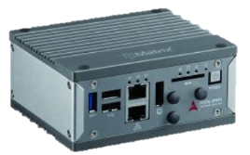
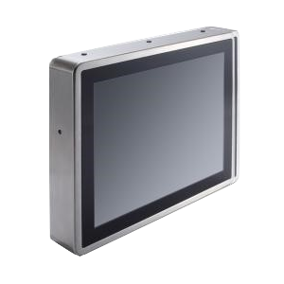
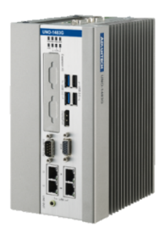
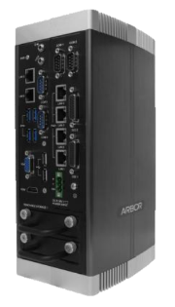
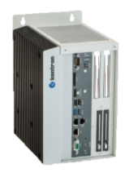
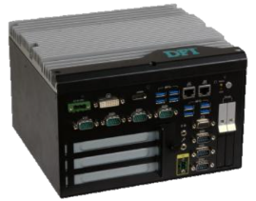
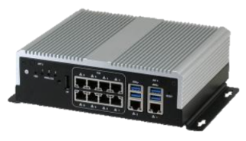
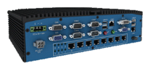
What is an industrial PC?
Ruggedized design
Wider operating temperature
Expansion options
Dust/water /immersion-proof
Enhanced emi filtering
Industrial grade components
Typically lasts 7-10 years
Purpose built for a factory
Photo source: Intel® IoT Solutions Alliance Solution Directory
Notes:
Key message: IPCs are built for industrial usage and typically last 7-10 years.
3 main form factors for IPCs. – Equipment mount, rack mount & panel mount.

Slide 10
Industrial Manufacturers Require Industrial Compute Today
The plant floor is a source of, and is powered by, data
Factories function more efficiently to reduce costs
Manufacturing flexibility matches consumer demands
Equipment management to improve quality
Optimized Production
An oil & gas refiner utilizes data collected through IPCs in the refinery & commodity market prices to now create a daily refining plan (was weekly)
Product Defect Detection
A manufacturer is using an IPC to detect product quality issues immediately – at the machine!
On-Demand Manufacturing
A FMCG company adjusts its mass-market production to switch products without line switching to match its digital strategy & grow revenue
Predictive Maintenance
Semiconductor maker monitors vibrations on equipment fans to predict fan failures – realizes higher equipment reliability & higher product yield
Notes:
Goal is to describe what IPCs can deliver today and the future proofing that can be done to prepare for what possibilities lie ahead.
Additional customer discovery can occur here to understand what the customer’s desired end state/goals are for digital factory transformation. Questions such as How do they handle sharing OT data with IT, how are they managing the data, etc. may be helpful.
We see the industry moving along these 4 value vectors—increased data, more functionality, greater flexibility, and higher quality. Listed here are use cases that are currently being deployed, evaluated, or in production.
(fast moving consumer goods = FMCG)
The semi company is Intel and has this used highlighted in the following whitepaper. https://www.intel.com/content/www/us/en/it-management/intel-it-best-practices/developing-a-scalable-predictive-maintenance-architecture-paper.html
We are not only making this technology possible, but using in our own factories.

Slide 11








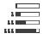


Industrial Edge Compute is Transforming
From This…
Proprietary, Specialized, Monolithic
To This…
Virtualized, Open, Interoperable
DCS
PLC
HMI
Robotics
MV
VM: DCS
On Prem Compute
(Edge to Fog)
VM: HMI
VM: PLC
VM: MV
Control
VM: MC
Machine
Sensors + Connectivity
Compute Node
On Prem
Data Center
Analytics
Analytics
enabled by Technical Pillars of Transformation
Virtualization
Security
Safety
Analytics (AI)
Machine vision
Real time
Notes:
Convergence is driving transformation in industrial IOT segments including manufacturing, energy, buildings, logistics. Similar to NFV and SDN for telcos.
Transformation on both HW and SW planes.
WC through virtualization is behind transformation.
Virtualization replaces purpose built devices; Intel offers many Si features such as Vt-D and Vt-X that allow for CPU, memory, and I/O voirtualization. In addition products like WR Titanium Control targets industrial segments and allows for consolidating traditional industrial control loops that could otherwise be challenging to integrate.
On the SW side, this convergence is also taking place. Multiple software programs -> one page of glass.
Six pillars of transformation -> heart of this convergence are what we call the six pillars of transformation.

Slide 12




Two Paths to Upgrade your Industrial PC
MES
APP1
APP2
APP…
Upgrade Software & Hardware
Legacy OS
Upgrade Hardware Only
OLD industrial pc
MES
APP1
APP2
APP…
Complete
Refresh
Legacy Compatibility
MES
APP1
APP2
APP…
Legacy OS
NEW OS
HYPERVISOR
Upgrade to the latest generation of hardware & update your SW applications and drivers
Maintain your existing software, I/O, applications while deploying latest generation HW and applications
NEW OS
NEW IPC HARDWARE
NEW IPC HARDWARE
* Other names and brands may be claimed as the property of others.
Notes:
Key Take Away Message:
Need to first understand what is customer’s use case. E.g: Are there any old IPCs still running? Are those IPCs posing any risks like HW failure, SW security issues? What I/O devices are they connected to? What operating systems are they running?
Depending on their use cases, we could drive the Awareness to do a complete refresh (without hypervisor) or drive the Enablement to keep legacy compatibility (with hypervisor)
Migration Guide is available to help the customer to shorten the migration cycle
Pro: No hypervisor. Smaller SW footprint & cost
advantage
Con: Longer time and effort in enabling legacy I/O
devices, legacy drivers and legacy applications that
do not support New O/S
Recommended: For cases where legacy devices,
drivers and applications that can work seamlessly
in new O/S environment
Pro: Saves time and effort in enabling legacy I/O
devices, legacy drivers and legacy applications that
do not support New O/S
Con: Need a hypervisor. Bigger SW footprint & may
involve hypervisor license
Recommended: For cases where legacy devices,
drivers and apps that CANNOT work seamlessly
in new O/S environment

Slide 13
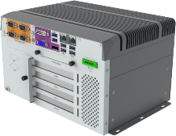
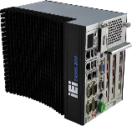
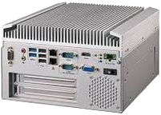
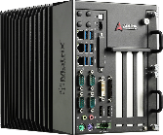
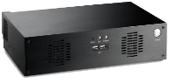
Production
Control & Automation
Improve Yield
Reduce Downtime
Optimization
Quality
Quality Management
Process Control
Inventory
Supply Chain Tracking
Location Sensors
Maintenance
Scheduled Downtime Augmented by Sensor-based Monitoring
Safety
Worker Safety Program
Safety Tracked Offline
Regulatory
System Compliance
Operational Conditions
Notes:
Engage with your audience with this slide and the next. <these are a ‘build’ and can be used without the other>
The goal of these slides is for customer discovery to allow for fine tuning your discussion on those elements that matter most to the customer.
Seek to understand what your customer’s digital objectives are and how those balance with their existing cost and quality goals. Some good questions to ask here are around what function their IPCs are perform, how old they are, which brand/s, what is MES software do they run, how do they procure, how do they manage, how often do they upgrade, etc.
Most end users will leverage IPCs to drive more production, better quality, and faster maintenance. → with the ultimate goal of more profit. Some end users are looking to use IPCs to improve other areas noted in this slide.

Slide 14
The Intel Developer Program

Slide 15
Enabling New Developer Opportunities
ACCESS TO KNOWLEDGE
ACCELERATED PROTOTYPING
DEFINE
What Intel Brings
OPTIMIZE
Common and seamless Developer experience
Start to finish technologies for robust solutions
Simplified path to develop and deploy products, systems, solutions
Reusability, extensibility, portability, future proof
The Developer’s Journey
Technology
EVALUATE
STREAMLINED
DEVELOPMENT
Developer Experience
Future Trends
DEVELOP
POWERFUL FOUNDATION OF IOT INGREDIENTS
MANAGE
DEPLOY
FAST DEPLOYMENTS
Notes:
Key Message: Intel creates new opportunities in the IoT developer journey, by leveraging deep understanding of IoT, in-house design/development expertise, silicon and software products, and strong ecosystem relationships to accelerate IoT architecting, development, and deployment.
Time is of the essence for IoT developers. Learning, evaluating, selecting, prototyping, and integrating takes time that the developer cannot afford in order to stay competitive.
Intel is working to accelerate and simplify the IoT developer experience in order to speed time to proofs of concept and help bring solutions to market faster that are designed to meet customer needs over long-term deployments.
From definition through evaluation of ingredients, technologies, and architectures, Intel offers tools, technologies, and proven developer kits with amazing out-of-box experiences to get you prototyping quickly.
Intel’s enablement in the developer journey is driven by our developer program that requires tools to be useful and proven, provide multiple points of entry along the developer journey, and designed to deliver more than just functionality. For our kits and tools, we provide documentation, a web portal, API references, robust code samples and tutorials, and paths to integration.

Slide 16

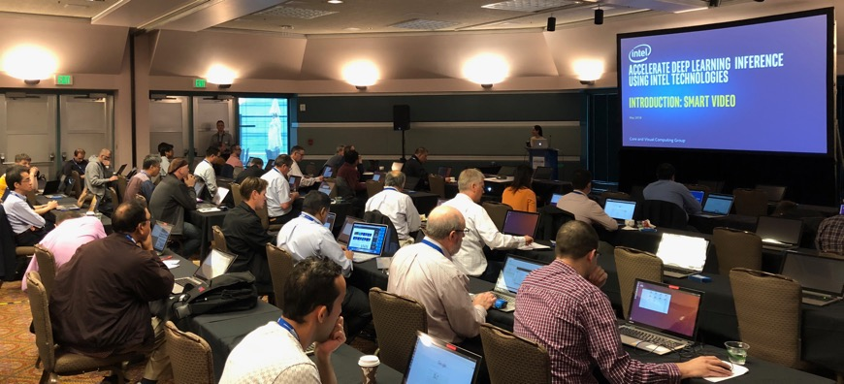
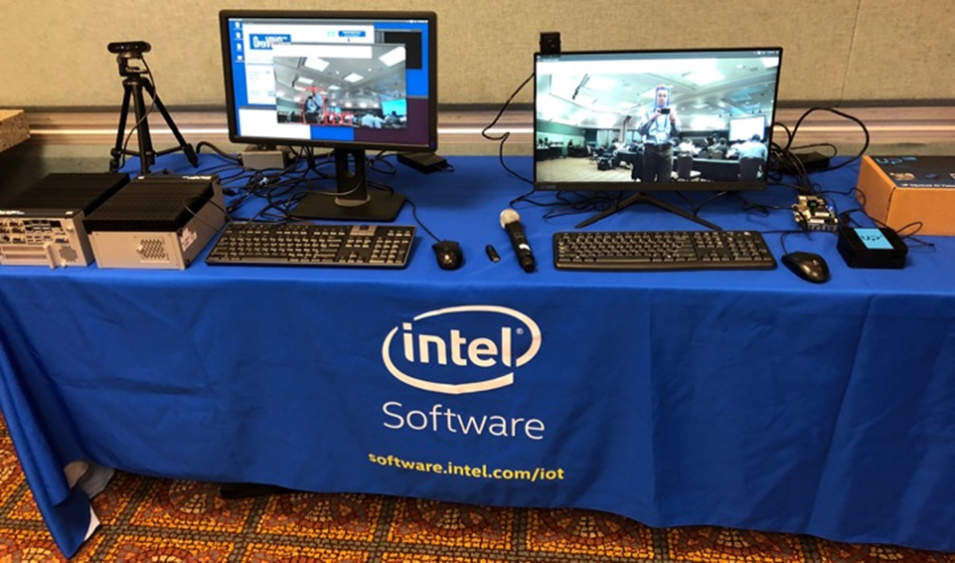

Engaging Through All Phases of Development
Prototype
Productize and Scale
Define
Events
Virtual/Tradeshows
(Global IoT DevFest)
Workshops
Hands-On Training
Promotion
Showcase Reference Implementations
IoT Innovators sharing Expertise
Engagements
ISV Engagement
App Enablement
Architecture Conversion
Notes:
Key Message: Beyond helping you accelerate development to deployment, Intel is engaged in understanding the IoT developers’ needs and challenges—from architecture to productization.

Slide 17
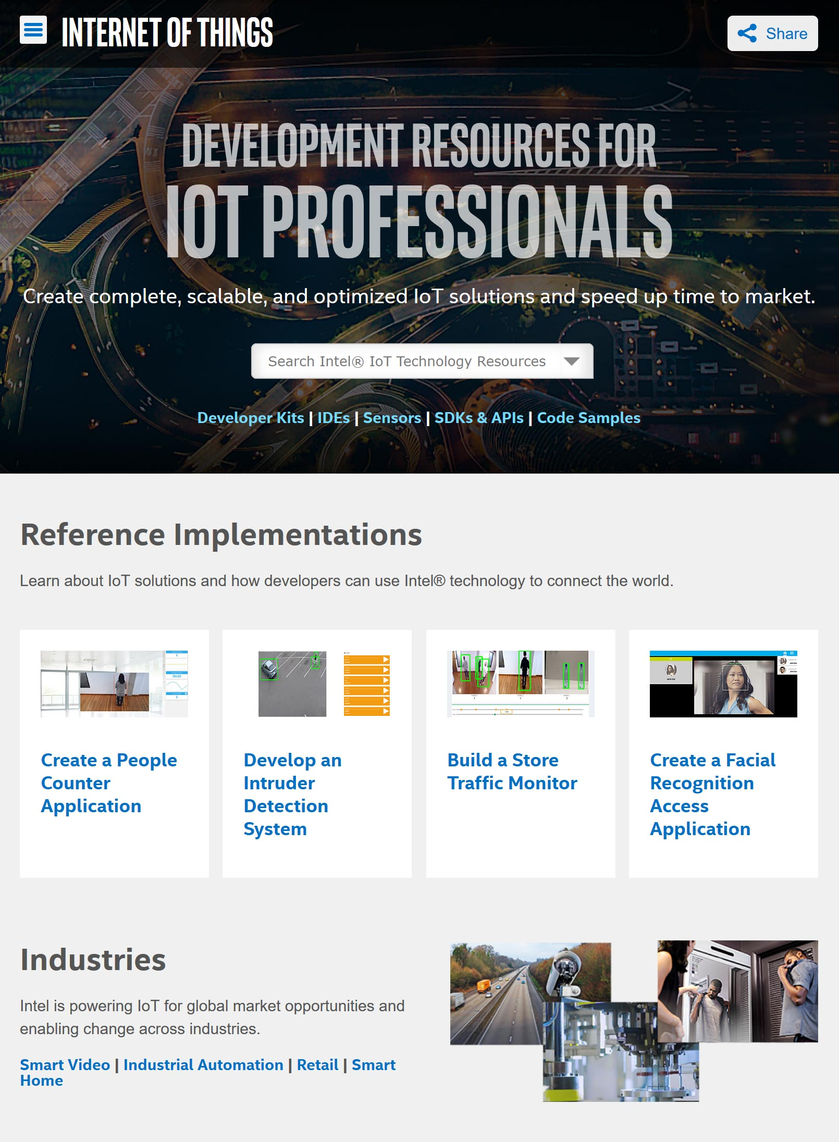
Intel Developer zone for iot: Central resource for E2E solution support
Training, How-Tos, Documentation, Forums, Support
Development Kits, SDKs, Libraries, Sensor Drivers, APIs, Tools
Code Samples and Tutorials, End-to-End Reference Implementations
Guides for Productization and Commercialization
software.intel.com/iot
Notes:
Key Message: Intel® Developer Zone (IDZ) is the hub for all IoT developer resources, including evolving knowledge, tools and SDKs, code samples, reference implementations, and tutorials, and productization and commercialization support.
The Intel Developer Zone is your one-stop shop for all things IoT.
When you need information, the IDZ is where to start. Information and experiences in IoT continually evolve, making the “Zone” a fresh and dynamic space for consuming content and interacting with others.
The IDZ is where you download tools and libraries, where you find out how to get develop kits from the ecosystem. We are continually developing new kits for new applications and use cases and adding optimized libraries, along with sample codes and more.
When it comes to moving your product on to the final stages, you can find resources to make the journey easier.
The IDZ is the richest resource from Intel for developers who are building innovative solutions.

Slide 18

OpenVINO* and Intel® Media SDK*

Slide 19


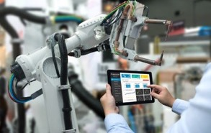




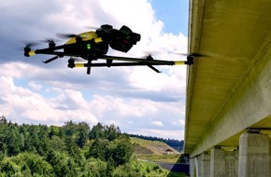
Emergency Response
Financial services
Machine Vision
Cities/transportation
Video based Analytics
Using computer vision and deep learning is growing rapidly
Autonomous Vehicles
Responsive Retail
Manufacturing
Public sector
Notes:
Gorilla Technologies* uses OpenVINO uses open vino technology to perform face and shoulders recognition to improve the accuracy of an intruder alert systems. They have a line crossing algorithm that determines if a person crosses a particular line on the video feed. they can perform business intelligence such as determining how long a person stands at a particular location within a store. They also have license plate recognition.
Advantech - has a real time shopping traffic mapping solution that helps retailers compete in an ever-changing, competitive marketplace
NexCOBOT - Is a robotics manufacturer and integrator that is using AI driven vision capabilities to improve quality and accuracy over traditional machine models. They have a line of robots that conduct automotive assembly using vision techniques based on Intel OpenVINO.
Phillips - Intel teamed up with Philips to show that servers powered by Intel® Xeon® Scalable processors could be used to efficiently perform deep learning inference on patients’ X-rays and computed tomography (CT) scans, without the need for accelerators. The ultimate goal for Philips is to offer artificial intelligence (AI) to its end customers without significantly increasing the cost of the customers’ systems and without requiring modifications to the hardware deployed in the field
Adlink - Edgar Chen, general manager, Embedded Platforms and Modules, ADLINK Technology is quoted as saying, “ADLINK is committed to bringing AI to the edge. We are taking a heterogeneous computing approach to AI deployments and building the right solution for our customer based on their computing needs. Using Intel® Vision Accelerator Design products with Intel® Movidius™ VPUs and the OpenVINO™ toolkit, Adlink’s AI platforms can speed up image processing, computer vision, and deep learning inferencing with power efficiency not yet fully recognized in the market. With these advantages, ADLINK can better target edge applications and infuse the power of AI in vertical markets including manufacturing, transportation, healthcare, retail, smart city, and more. Specifically, by leveraging the OpenVINO™ toolkit we saw more than an 11x increase in performance1 on the CPU vs. running without the OpenVINO™ toolkit. Even more compelling is the 19x performance increase2 we saw when we added our own EDL-mPCIe-MA2485*, a mini-PCIe* accelerator card based on the Intel® Vision Accelerator Design.” —Edgar Chen, general manager, Embedded Platforms and Modules, ADLINK Technology
Public Section Uses of Intel Smart Video Technology
Public Safety & City Surveillance
Crime, violence, terrorism, vandalism
Illegal and/or excessive crowding
Unauthorized movement in restricted areas
Abandoned objects
Critical Infrastructure
Perimeter protection of remote sites
Loitering in sensitive, sterile zones
Safeguard assets for uninterrupted operations
Situational awareness
Transportation & Public Transit
Traffic management
Obstacles, slip and fall scenarios
Transit Platform/track security
Statistics and path analysis
Campus & Education
High-value asset protection
Unauthorized after-hours access
Security and safety incidents
Post-event investigation
Advanced medical research, personalized healthcare, smart transportation, cities, manufacturing, retail, supply chain management—the industries that rely on video for critical insight and competitive growth are everywhere.
Up to $11 billion in edge to cloud industry growth is expected between now and 2021. Video captured at the edge by smart devices, sensors, and connected things represents a huge portion—$6 billion—of this IoT opportunity for everything from smart manufacturing to smart cities.

Slide 20




What it is
A toolkit to accelerate development of high performance computer vision & deep learning inference into vision/AI applications used from edge to cloud. It enables deep learning on hardware accelerators and easy deployment across multiple types of Intel® platforms.
Who needs this product?
Computer vision, deep learning software developers
Data scientists
OEMs, ISVs, System Integrators
Usages
Security surveillance, robotics, retail, healthcare, AI, office automation, transportation, non-vision use cases (speech, text) & more.
High performance, perform ai at the edge
Streamlined & Optimized deep learning inference
Heterogeneous, cross-platform flexibility
Free Download  software.intel.com/openvino-toolkit
Open Source version  01.org/openvinotoolkit
Latest version is 2019 R1
Notes:
Together, Intel® Hardware & Software delivers high performance deep learning inference, analytics, & real-time image analysis for vision solutions, providing customers flexibility, cost-efficiencies & faster deployments.
Advance AI Performance in Edge Devices with Intel® Distribution of OpenVINO™ toolkit
Advancing vision solutions for AI at the edge, the latest release of the Intel® Distribution of OpenVINO™ toolkit (2018 R4) supports new Intel® Vision Accelerator Design products—that when used together, deliver high performance deep learning inference, analytics, and real-time image analysis.
This hardware/software combination unleashes new levels of performance¹, and provides flexibility, cost-efficiencies and faster deployments. Other new features in the toolkit expand support for public deep learning topologies and add three pretrained models.
Yolo V3 - Not available in downloader, but tested and validated
NCS2 - JB announcing in Beijing at AIDC, available on Amazon for purchase
Demand is growing for intelligent vision solutions.
Deep learning revenue is estimated to grow from $655M in 2016 to $35B by 2025¹.
This requires developer tools to integrate computer vision, deep learning, and analytics processing capabilities into applications, so they can help turn data into insights that fuel artificial intelligence.
¹Tractica 2Q 2017

Slide 21


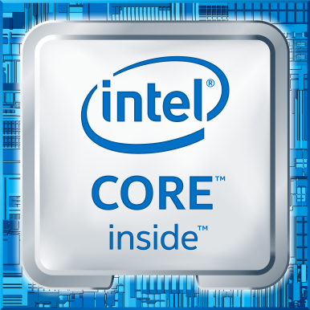




What’s Inside Intel® Distribution of OpenVINO™ toolkit
Deep Learning
Traditional Computer Vision
Intel® Deep Learning Deployment Toolkit
Optimized Libraries & Code Samples
OpenCV*
OpenVX*
Samples
Model Optimizer Convert & Optimize
IR
Inference Engine
Optimized Inference
For Intel® CPU & GPU/Intel® Processor Graphics
IR = Intermediate Representation file
Tools & Libraries
Open Model Zoo
Increase Media/Video/Graphics Performance
40+ Pretrained Models
Samples
Model Downloader
Intel® Media SDK Open Source version
OpenCL™ Drivers & Runtimes
Deep Learning Workbench
For GPU/Intel® Processor Graphics
Optimize Intel® FPGA (Linux* only)
Calibration Tool
Model Analyzer
Benchmark App
Accuracy Checker
Aux. Capabilities
FPGA RunTime Environment (from Intel® FPGA SDK for OpenCL™)
Bitstreams
OS Support: CentOS* 7.4 (64 bit), Ubuntu* 16.04.3 LTS (64 bit), Microsoft Windows* 10 (64 bit), Yocto Project* version Poky Jethro v2.0.3 (64 bit), macOS* 10.13 & 10.14 (64 bit)
Intel® Architecture-Based Platforms Support
Intel® Vision Accelerator Design Products &
AI in Production/ Developer Kits
An open source version is available at 01.org/openvinotoolkit (some deep learning functions support Intel CPU/GPU only).
OpenVX and the OpenVX logo are trademarks of the Khronos Group Inc.
OpenCL and the OpenCL logo are trademarks of Apple Inc. used by permission by Khronos
Notes:
This toolkit is designed to increase performance and reduce development time for computer vision solutions. It simplifies access to the benefits from the rich set of hardware options available from Intel which can increase performance, reduce power, and maximize hardware utilization – letting you do more with less and opening new design possibilities.
Deep Learning Deployment Toolkit
A Cross-platform Tool to Accelerate Deep Learning Inference Performance
Model Optimizer, converting Caffe, TensorFlow, & MXnet to IR.
Inference Engine, with plugins for CPU, GPU, FPGA & VPU – what it is… across multi-platform support
OpenCV
Pre-compiled OpenCV 3.3, Full Intel CPU optimizations
New Intel Photography Vision Library, with face detection/ recognition, blink detection, and smile detection
OpenVX
Graph-based implementation of a short list of traditional CV operations and CNN primitives.
Khronos OpenVX* Neural Networks Extension 1.2
Visual Algorithm Designer
Eclipse* plugin enabling integrated OpenVX* application development
Miscellaneous
OpenCL™ Drivers & Runtimes, and Media drivers are included to ease Computer Vision SDK working with Intel® Media SDK and Intel SDK OpenCL™ Applications
MKL-DNN, CLDNN are included in common API – no need to download separate

Slide 22
Intel® Deep Learning Deployment Toolkit
Take Full Advantage of the Power of Intel® Architecture
Model Optimizer
What it is: Preparation step -> imports trained models
Why important: Optimizes for performance/space with conservative topology transformations; biggest boost is from conversion to data types matching hardware.
Inference Engine
What it is: High-level inference API
Why important: Interface is implemented as dynamically loaded plugins for each hardware type. Delivers best performance for each type without requiring users to implement and maintain multiple code pathways.
Extendibility C++
Trained Model
CPU Plugin
Convert & optimize to fit all targets
Inference Engine
Common API (C++ / Python)
Optimized cross-platform inference
Extendibility OpenCL™
Caffe*
Model Optimizer
Convert & Optimize
GPU Plugin
Extendibility OpenCL
Tensor Flow*
IR
FPGA Plugin
IR
.data
MxNet*
Load, infer
Extendibility OpenCL (1H’19)
Myriad Plugin
Kaldi*
IR = Intermediate Representation format
GNA Plugin
GPU = Intel CPU with integrated graphics processing unit/Intel® Processor Graphics

Slide 23
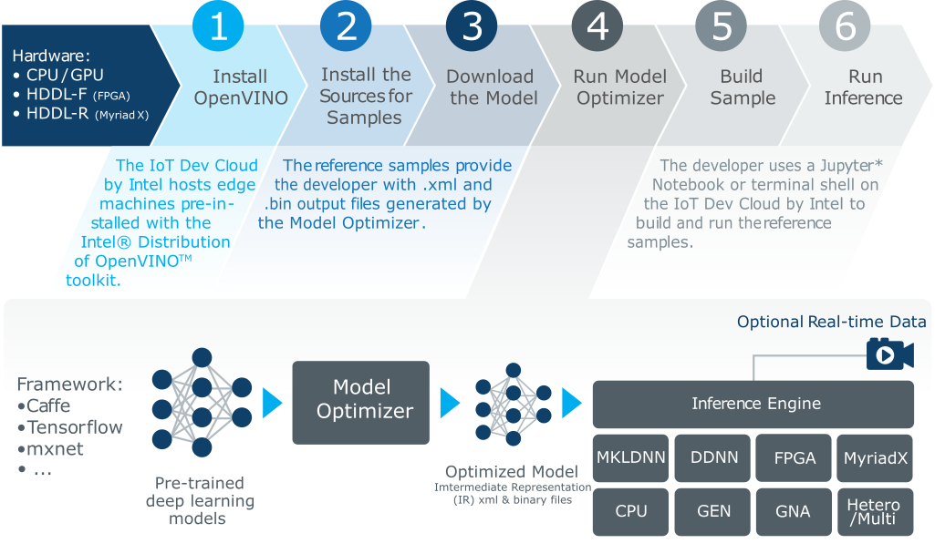
Developer Workflow

Slide 24
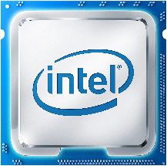
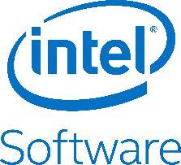
Intel as Best Choice for Vision Solutions
Deliver High Performance Computer Vision & Deep Learning Transform Data & Results into Artificial Intelligence
Intel offers the broadest portfolio of hardware and software that help you
Accelerate workloads for a wide range of solutions and vertical use cases
Increase application performance through Intel accelerators and flexible heterogeneous architectures¹ (CPU, CPU w/integrated graphics (GPU), FPGA, and Vision Processing Units (VPU))
Drive power, cost and development efficiencies to designs and applications for cameras, gateways, network video recorders, and servers
Enable deep learning capabilities for smarter, faster analytics—transform data into artificial intelligence for competitive advantage
¹Certain technical specifications and select processors/skus apply. See product site for more details.
Notes:
Together, the best hardware and software give the media industry the tools they need to accelerate content creation to mass distribution to millions of consumers.
HW details
Core & Xeon processors are a great choice for video gateway and network video recorder solutions, data center media workflows in comms & cloud infrastructure: video transcode & analytics, remote desktop & gaming. Intel Media Server Studio is a comprehensive set of tools for such applications that provides access to Quick Sync Video – hardware accelerated encode, decode & processing – that allows to achieve high density transcoding with up to 18 AVC HD@30fps sessions per Xeon E3 v5 socket (refer to benchmarks)
And at clients side with collection of Atom & Core chips, for video players and editors, as well as car infotainment & cluster display, Media SDK for Windows & Embedded Linux delivers easy to use API for encode & playback.
Intel Atom system on chips fit perfectly for edge and video acquisition step, with smart cameras and connected cars designs, & Intel delivers Media SDK for Embedded Linux with support of Yocto OS to give developers outstanding video processing performance in a compact form factor.
For software –
Intel provides developer tools that bring out all the great capabilities of Intel hardware: media accelerators, Intel Quick Sync Video, along with media codecs,
and performance and quality analysis that drive fast video processing and ensure efficient density and high quality

Slide 25
Choosing the “Right” Hardware
Power/Performance Efficiency Varies
Running the right workload on the right piece of hardware → higher efficiency
Hardware acceleration is a must
Heterogeneous computing?
Tradeoffs
Power/performance
Price
Software flexibility, portability
Dedicated Hardware
Vision Processing Efficiency
X100
Vision DSPs
X10
FPGA
Power Efficiency
GPU
CPU
X1
Computation Flexibility
Notes:
So we want to run the right task on the best, most efficient silicon device.
Considering the tight requirements for power and performance, it is obvious that in order to be competitive we must use accelerators.
But what if my workload consist of many different tasks, some tasks will run better on CPU, Some better on GPU and so on?
Can I run each portion of the code on a different device?
This is what we call Heterogeneous computing,
Balancing a workload across multiple devices is a tricky task, and need to take into account more than just the compute power of the accelerator
Transferring the data to and back from the accelerator (for example) might kill the benefit of using it at all.
How to know? Usually it’s best to just try, I’ll show an example.
So we need to consider all of these factors and more.
The good news is that Intel has a wide range of silicon solutions we can choose from…
We cannot discuss all of the tradeoffs and the options here, but let me refer you to performance.intel.com XXXXX

Slide 26

























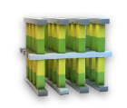
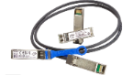


Intel Computer Vision Portfolio
experiences
Intel® Parallel Studio XE Intel® Media SDK / Media Server Studio
Intel® System Studio Intel® Distribution of OpenVINO™ toolkit
Intel® SDK for OpenCL™ Applications
Unleash
potential
tools
Full
Frameworks
Mlib BigDL
Intel® Data Analytics Acceleration Library
Intel® Distribution for
Intel® Nervana™ Graph
libraries
Intel® Math Kernel Library
Movidius Stack
hardware
Compute
Memory & Storage
Networking
Visual Intelligence
OpenVX and the OpenVX logo are trademarks of the Khronos Group Inc.
OpenCL and the OpenCL logo are trademarks of Apple Inc. used by permission by Khronos
Notes:
Intel has the best in class hardware portfolio for machine & deep learning, but software is critical to unleashing the full compute potential. To that end, Intel offers an optimized software stack in order to deliver game-changing AI applications.
At the lowest level, Intel optimized primitive functions that are used across a wide array of machine & deep learning frameworks and solutions, including the Math Kernel Library (MKL), Data Analytics Acceleration Library (DAAL), and Intel Python distribution.
At the framework level, Intel is committed to optimizing the most popular analytics, machine & deep learning frameworks by the end of 2016. As far as tools, Intel offers the DL Studio to accelerate deep learning training & deployment, the Saffron Natural Intelligence Platform for reasoning systems, and we are a key contributor to the Trusted Analytics Platform for classic machine learning and data analytics.
The vertical separator delineates libraries/frameworks/tools that are machine & deep learning centric (left) from those that are memory-based reasoning (right).

Slide 27
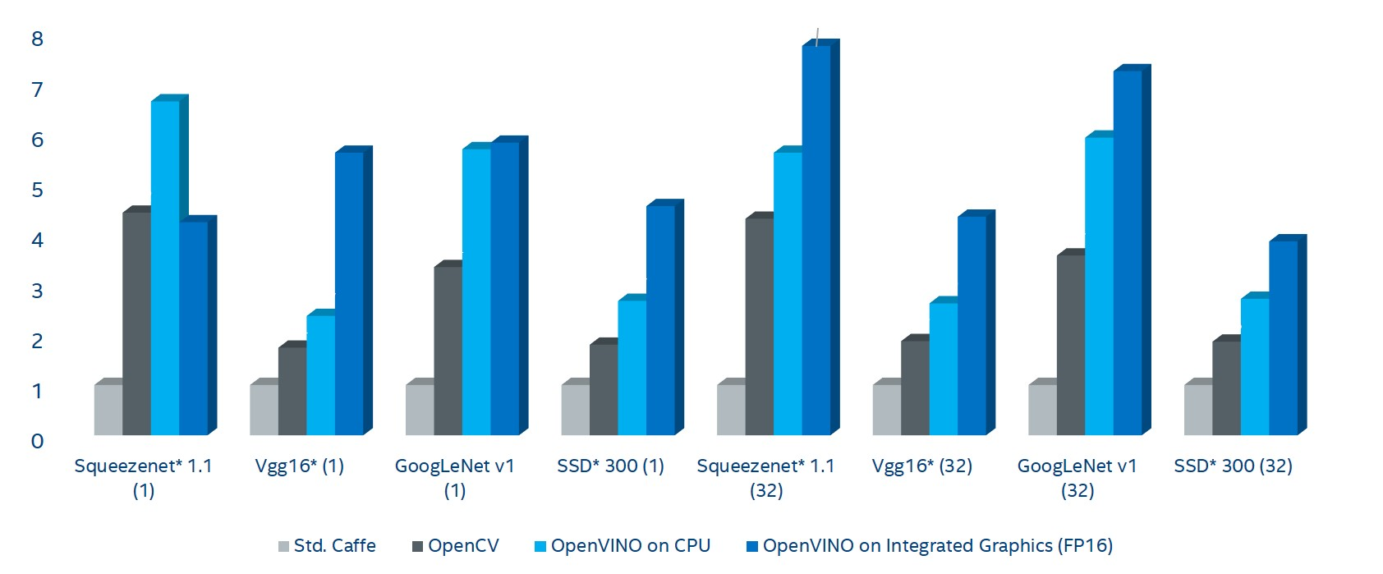
Increase Deep Learning Workload Performance on Public Models
Comparison of Frames per Second (FPS)
7.73x
Relative Performance Improvement
Standard Caffe*
Baseline
Public Models (Batch Size)
OpenVINO on CPU+Intel® Processor Graphics (GPU) / (FP16)
Fast Results on Intel Hardware, even before using Accelerators
¹Depending on workload, quality/resolution for FP16 may be marginally impacted. A performance/quality tradeoff from FP32 to FP16 can affect accuracy; customers are encouraged to experiment to find what works best for their situation. The benchmark results reported in this deck may need to be revised as additional testing is conducted. Performance results are based on testing as of April 10, 2018 and may not reflect all publicly
available security updates. See configuration disclosure for details. No product can be absolutely secure. For more complete information about performance and benchmark results, visit www.intel.com/benchmarks. Configuration: Testing by Intel as of April 10, 2018. Intel® Core™ i7-6700K CPU @ 2.90GHz fixed, GPU GT2 @ 1.00GHz fixed Internal ONLY testing, Test v312.30 – Ubuntu* 16.04, OpenVINO™ 2018 RC4. Tests were based on various parameters such as model used (these are public), batch size, and other factors. Different models can be accelerated with different Intel hardware solutions, yet use the same Intel software tools.
Intel’s compilers may or may not optimize to the same degree for non-Intel microprocessors for optimizations that are not unique to Intel microprocessors. These optimizations include SSE2, SSE3, and SSSE3 instruction sets and other optimizations. Intel does not guarantee the availability, functionality, or effectiveness of any optimization on microprocessors not manufactured by Intel. Microprocessor-dependent optimizations in this fixed product are intended for use with Intel microprocessors. Certain optimizations not specific to Intel microarchitecture are reserved for Intel microprocessors. Please refer to the applicable product User and Reference Guides for more information regarding the specific instruction sets covered by this notice. Notice revision #20110804
Notes:
Testing details: Tested topologies are split into 2 types: Public - topologies reported in papers and publicly available. Intel - topologies that are used @ Intel (either developed for customer enabling, own products or experimental results). Readiness of the topology indicates maturity of the product (Research->POC->Internal Reference-> Near Production Worthy-> Production Worthy) Testing methodology: - End 2 End. Each topology is passed through Model Optimizer and executed on target hardware for Inference Engine. For caffe, no modifications on model are done. - Results of execution are compared against caffe version. Error threshold is as follows: - 10e-4 for classification networks - 1 pixel difference in bounding box coordinates + 10e-4 difference in confidence for detection networks - Each network is executed for at least 20 seconds in a loop, minimum 10 executions done. Measured times are filtered to take 3 Sigma range. Other measurements are discarded. Out of remaining measurements, median value is taken. HW and SW details for targets are described in detail on System Configuration spreadsheet. Benchmark results in FPSes are reported on Benchmark results spreadsheet. Color codings are as follows: Fastest framework for target Results do not match caffe reference Test did not finish Test was not run Column descriptions: MaxMem is a theoretical memory consumption of the network for inference considering that memory is NOT reused, i.e. if all internal feature maps are stored in memory simultaneously. MinMem is absolute minimum of memory that network needs for inference. I.e. largest of needs from all layers. MaxMem and MinMem are measured in millions of activations (to get actual memory size multiply by activation size, i.e. fp16 for Movidius). Does not consider weights, those are shown in Mparam. Gflop number are actual operations, not MACs. Counted for known layers (mostly convolutions, FCs, etc.). Custom layers are not considered. Mparam numbers are reported for known layers only. Number is actual amount of parameters. To get amount of bytes number should be multiplied by size of weight (e.g. fp16 for Movidius). Input image is given as a size of first input blob for a network. Network execution time is split into times taken by individual layer types (Convolution, Pooling, etc.). Breakdown is reported for each topology, target and plugin on Execution breakdown spreadsheet. 100% correspond to entire network time. %% number indicates to relative number that individual layer type takes. Layer types and their parameters that are used by each topology are reported on Layers per topology list. Number on this sheet shows how many times particular layer with given parameters is used in a topology.

Slide 28
Increase Deep Learning Workload Performance on Public Models: Comparison of Frames per Second (FPS)
19.9x¹
Relative Performance
Improvement
Standard Caffe*
Baseline
Public Models (Batch Size)
OpenVINO on CPU+ Intel® Processor Graphics (GPU)/ (FP16)
OpenVINO on CPU+Intel® FPGA
Get an even Bigger Performance Boost with Intel® FPGA
¹Depending on workload, quality/resolution for FP16 may be marginally impacted. A performance/quality tradeoff from FP32 to FP16 can affect accuracy; customers are encouraged to experiment to find what works best for their situation. Performance results are based on testing as of June 13, 2018 and may not reflect all publicly available security updates. See configuration disclosure for details. No product can be absolutely secure. For more complete information about performance and benchmark results, visit www.intel.com/benchmarks. Configuration: Testing by Intel as of June 13, 2018. Intel® Core™ i7-6700K CPU @ 2.90GHz fixed, GPU GT2 @ 1.00GHz fixed Internal ONLY testing, Test v3.15.21 – Ubuntu* 16.04, OpenVINO 2018 RC4, Intel® Arria® 10 FPGA 1150GX. Tests were based on various parameters such as model used (these are public), batch size, and other factors. Different models can be accelerated with different Intel hardware solutions, yet use the same Intel software tools.
Intel’s compilers may or may not optimize to the same degree for non-Intel microprocessors for optimizations that are not unique to Intel microprocessors. These optimizations include SSE2, SSE3, and SSSE3 instruction sets and other optimizations. Intel does not guarantee the availability, functionality, or effectiveness of any optimization on microprocessors not manufactured by Intel. Microprocessor-dependent optimizations in this product are intended for use with Intel microprocessors. Certain optimizations not specific to Intel microarchitecture are reserved for Intel microprocessors. Please refer to the applicable product User and Reference Guides for more information regarding the specific instruction sets covered by this notice. Notice revision #20110804
Notes:
From worksheet 3.6 on 1/7/2018
Columns K, AB-AF
Tested topologies are split into 2 types: Public - topologies reported in papers and publicly available. Intel - topologies that are used @ Intel (either developed for customer enabling, own products or experimental results). Readiness of the topology indicates maturity of the product (Research->POC->Internal Reference-> Near Production Worthy-> Production Worthy) Testing methodology: - End 2 End. Each topology is passed through Model Optimizer and executed on target hardware for Inference Engine. For caffe, no modifications on model are done. - Results of execution are compared against caffe version. Error threshold is as follows: - 10e-4 for classification networks - 1 pixel difference in bounding box coordinates + 10e-4 difference in confidence for detection networks - Each network is executed for at least 20 seconds in a loop, minimum 10 executions done. Measured times are filtered to take 3 Sigma range. Other measurements are discarded. Out of remaining measurements, median value is taken. HW and SW details for targets are described in detail on System Configuration spreadsheet. Benchmark results in FPSes are reported on Benchmark results spreadsheet. Color codings are as follows: Fastest framework for target Results do not match caffe reference Test did not finish Test was not run Column descriptions: MaxMem is a theoretical memory consumption of the network for inference considering that memory is NOT reused, i.e. if all internal feature maps are stored in memory simultaneously. MinMem is absolute minimum of memory that network needs for inference. I.e. largest of needs from all layers. MaxMem and MinMem are measured in millions of activations (to get actual memory size multiply by activation size, i.e. fp16 for Movidius). Does not consider weights, those are shown in Mparam. Gflop number are actual operations, not MACs. Counted for known layers (mostly convolutions, FCs, etc.). Custom layers are not considered. Mparam numbers are reported for known layers only. Number is actual amount of parameters. To get amount of bytes number should be multiplied by size of weight (e.g. fp16 for Movidius). Input image is given as a size of first input blob for a network. Network execution time is split into times taken by individual layer types (Convolution, Pooling, etc.). Breakdown is reported for each topology, target and plugin on Execution breakdown spreadsheet. 100% correspond to entire network time. %% number indicates to relative number that individual layer type takes. Layer types and their parameters that are used by each topology are reported on Layers per topology list. Number on this sheet shows how many times particular layer with given parameters is used in a topology.

Slide 29
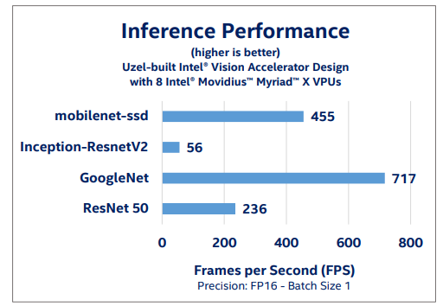
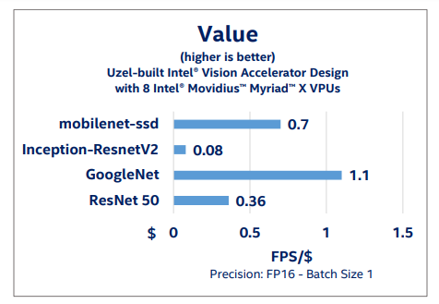
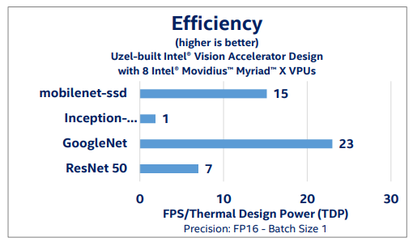
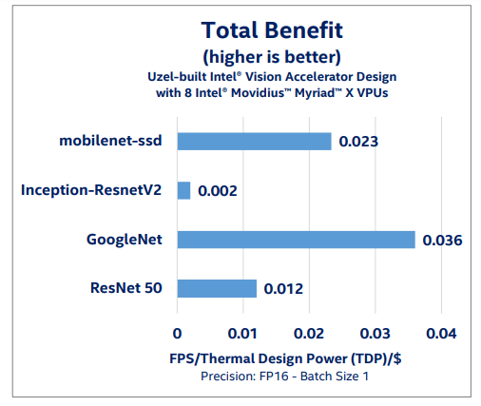
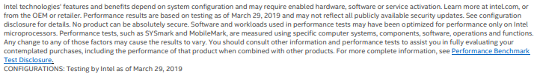
New Benchmarks for HDDL Accelerators – June 2019 Increase Deep Learning Model Performance with Intel® Movidius™ VPU & Intel® Distribution of OpenVINO™ toolkit Location: Intel® Distribution of OpenVINO™ toolkit product site > Hardware > Performance Benchmarks
See slide 59 for configuration details.
Intel’s compilers may or may not optimize to the same degree for non-Intel microprocessors for optimizations that are not unique to Intel microprocessors. These optimizations include SSE2, SSE3, and SSSE3 instruction sets and other optimizations. Intel does not guarantee the availability, functionality, or effectiveness of any optimization on microprocessors not manufactured by Intel. Microprocessor-dependent optimizations in this product are intended for use with Intel microprocessors. Certain optimizations not specific to Intel microarchitecture are reserved for Intel microprocessors. Please refer to the applicable product User and Reference Guides for more information regarding the specific instruction sets covered by this notice.
Notice revision #20110804

Slide 30
Speed Deployment with Pretrained Models & Samples
Pretrained Models in Intel® Distribution of OpenVINO™ toolkit
Age & Gender
Face Detection–standard & enhanced
Head Position
Human Detection–eye-level & high-angle detection
Detect People, Vehicles & Bikes
License Plate Detection: small & front facing
Vehicle Metadata
Human Pose Estimation
Action recognition – encoder & decoder
Text Detection & Recognition
Vehicle Detection
Retail Environment
Pedestrian Detection
Pedestrian & Vehicle Detection
Person Attributes Recognition Crossroad
Emotion Recognition
Identify Someone from Different Videos–standard & enhanced
Facial Landmarks
Gaze estimation
Identify Roadside objects
Advanced Roadside Identification
Person Detection & Action Recognition
Person Re-identification–ultra small/ultra fast
Face Re-identification
Landmarks Regression
Smart Classroom Use Cases
Single image Super Resolution (3 models)
Instance segmentation
and more…
Binary Models
Face Detection Binary
Pedestrian Detection Binary
Vehicle Detection Binary
ResNet50 Binary
Expedite development, accelerate deep learning inference performance, speed production deployment
Notes:
The toolkit includes optimized pretrained models to expedite development and improve deep learning inference on Intel® processors, and speed production deployment without the need to search for or to train your own models.

Slide 31


Workflow of Applying OpenVINO in CV Applications, Accelerate Streaming Performance
Using Intel® Media SDK and the OpenVINO™ toolkit together enables customers to build high performance, intelligent vision solutions.
OpenVINO™ Toolkit
Intel® Media SDK
OpenCV Library
OpenCV Library
Intel® Media SDK
Decode
Pre-Processing
Inference
Post-Processing
Encode
CPU
GPU
CPU
GPU
FPGA
VPU
CPU
GPU
Trained Model
Model
Optimizer
IR Model:
.xml
.bin

Slide 32




Intel® Media SDK
API to Access Intel® Quick Sync Video: Hardware Accelerated Encoding, Decoding, and Processing
Benefits
Outstanding performance
Rich API to tune encoding pipeline
Future proofed: support new processor without code changes
H.265 (HEVC)
H.264 (AVC)
MPEG-2 and more
Resize, scale, deinterlace
Color conversion, composition
Denoise, sharpen, and more
Targeting Digital Security and Surveillance, Connected Car Applications, and More
Smart Camera
Embedded Linux*
using
and
Car Infotainment and
Cluster Display
Intel Atom®, Pentium®, and Celeron® ¹
¹ Intel® Celeron® Processor N3350, Intel® Pentium® Processor N4200, Intel Atom® E3930, E3940, E3950 processors
Notes:
Though OpenVINO provides DL inference and traditional CV operations, but another big bottleneck in many applications is codec processing. Encode for streaming out can be especially expensive. Media SDK enable real-time, hardware-accelerated video encoding, decoding, and processing. Run video and image processing with outstanding performance and high visual quality completely on the GPU while using the CPU for other tasks.
Intel® Media SDK—With the Intel® Media SDK, you can develop professional-grade media and video applications for digital surveillance, retail, industrial, smart home, video conferencing, and more using the libraries, tools, and samples it includes. Its single API enables hardware acceleration for fast video transcoding, image processing, and media workflows, while helping you tap into Intel® Quick Sync Video capabilities. Accelerate rich media performance; speed up video playback, encoding, processing, and media formatting conversion. Cut product time to market; prototype, optimize, and productize your media pipelines with a comprehensive, convenient API. Speed transition to new codecs. Use efficient codecs with hardware acceleration to increase speed, compression, and quality across AVC, HEVC, and MPEG-2. And debug and customize quickly; find and solve application bugs, port applications to new operating systems, and add new features using source code for open source Linux*.

Slide 33
Intel Integrated Graphics
System Agent
(Display, Memory, and IO Controls)
Gen is the internal name for Intel’s on-die GPU solution. It’s a hardware ingredient with various configurations.
Intel® Core™ Processors include Gen hardware.
Gen GPUs can be used for graphics and also as general compute resources.
Libraries contained in the Intel® Distribution of OpenVINO™ toolkit (and many others) support Gen offload using OpenCL™.
CPU
core
CPU
core
Memory & IO Interfaces
Shared Last-Level Cache
CPU
core
CPU
core
Gen 9 GPU
6th Generation Intel® Core™ i7 (Skylake) Processor

Slide 34




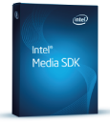
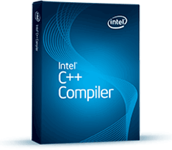

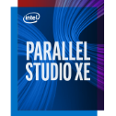
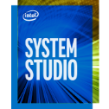

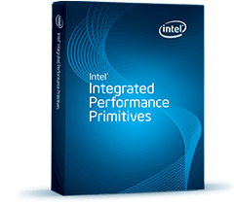
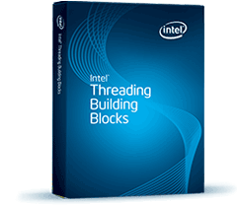




Putting It All Together
A major challenge is to get all these tool and libraries to work together in the best possible way to minimize development time and optimize system power/performance. A good way to abstract that workload is using an end-to-end pipeline
Computer Vision
Deep Learning
Media
Optimized CV
Capabilities
Intel® Deep Learning
Deployment Toolkit
*
Intel® Media SDK
SDKs
OpenCV
Intel® Distribution of OpenVINO™ Toolkit
Tools
Compiler, Analyzers, Debuggers
OpenCL™ SDK
IPP
TBB
Intel® MKL-DNN
CL-DNN
Intel® MKL
Libraries
OpenCL™
DAAL
Intel distribution

Slide 35

Call to Action and Resources
Download 
Free Intel® Distribution of OpenVINO™ toolkit
Get started quickly with:
Developer resources
Online webinars, tool how-tos & quick tips
Hands-on developer workshops
Support
Connect with Intel engineers & computer vision experts at the public Community Forum
Select Intel customers may contact their Intel representative for issues beyond forum support.
Notes:
Get the right download for your OS…
Access these resources to get started, develop quicker
Access other Intel Software Tools that can help you build your solution faster
- Intel System Studio
- Intel® Media SDK
- Intel® SDK for OpenCL™ Applications
- Deep Learning Tools from Intel
- Intel® Context Sensing SDK

Slide 36
IOT dev cloud by Intel®

Slide 37
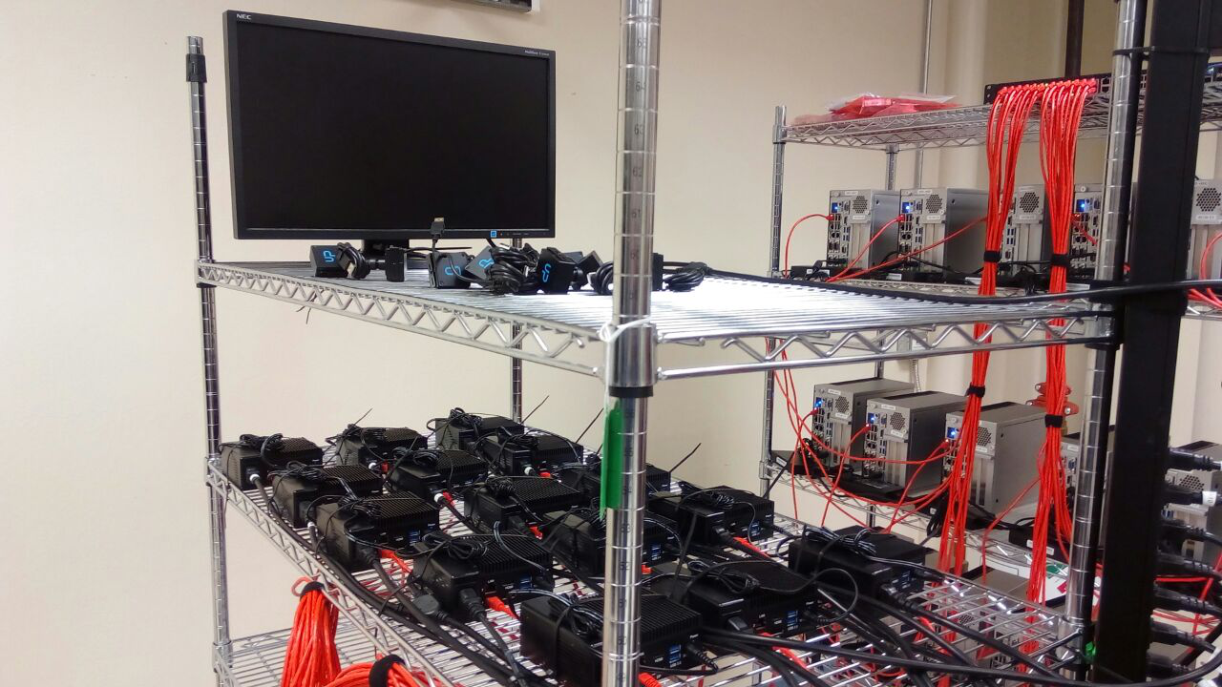
Intel IoT Developer Cloud
CLOUD-BASED HETEROGENEOUS EDGE DEVELOPMENT ENVIRONMENT
KEY BENEFITS
Easily evaluate the power of Intel’s heterogeneous edge compute processors: CPU, CPU with Integrated Graphics, FPGA,VPU
Learn to develop vision inference solutions with OpenVINO™ toolkit
Get started with complete examples, modify and upload your own models/workloads
Evaluate and compare various IoT Developer Kit offerings, software stacks and edge stacks
Getting started immediately without waiting to buy edge hardware
Notes:
GOOD
Back up slide -

Slide 38

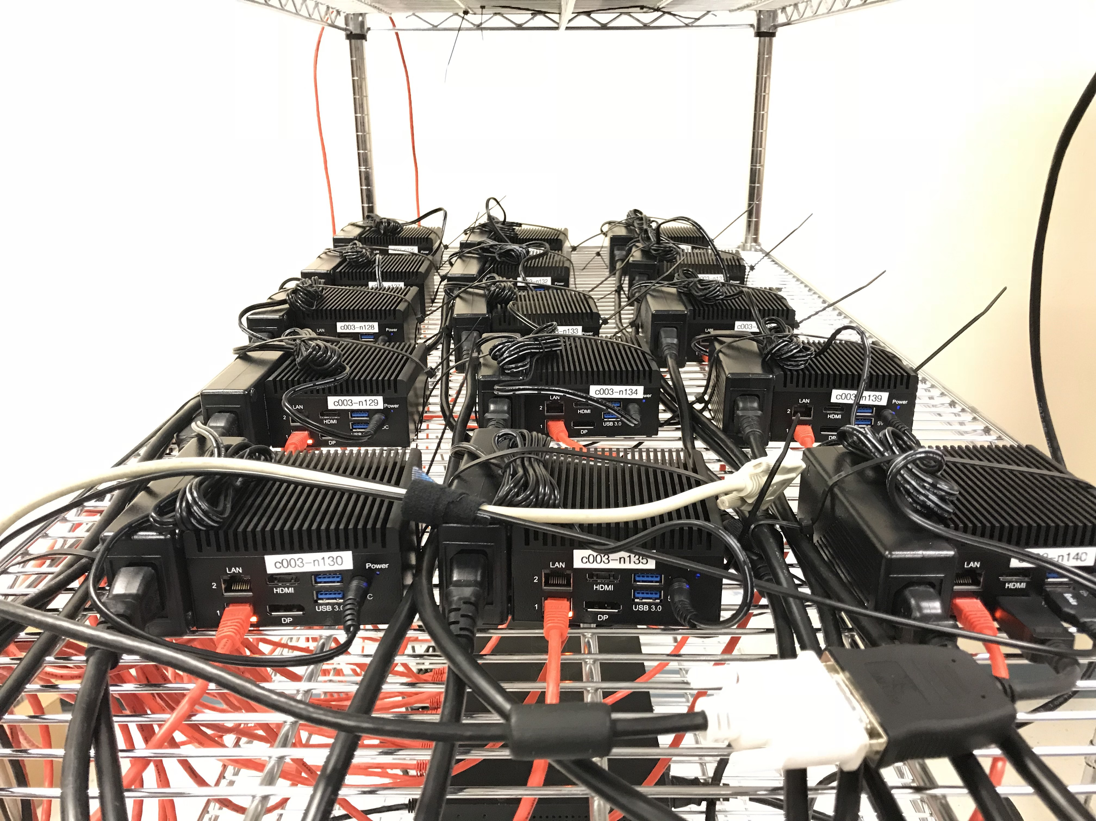
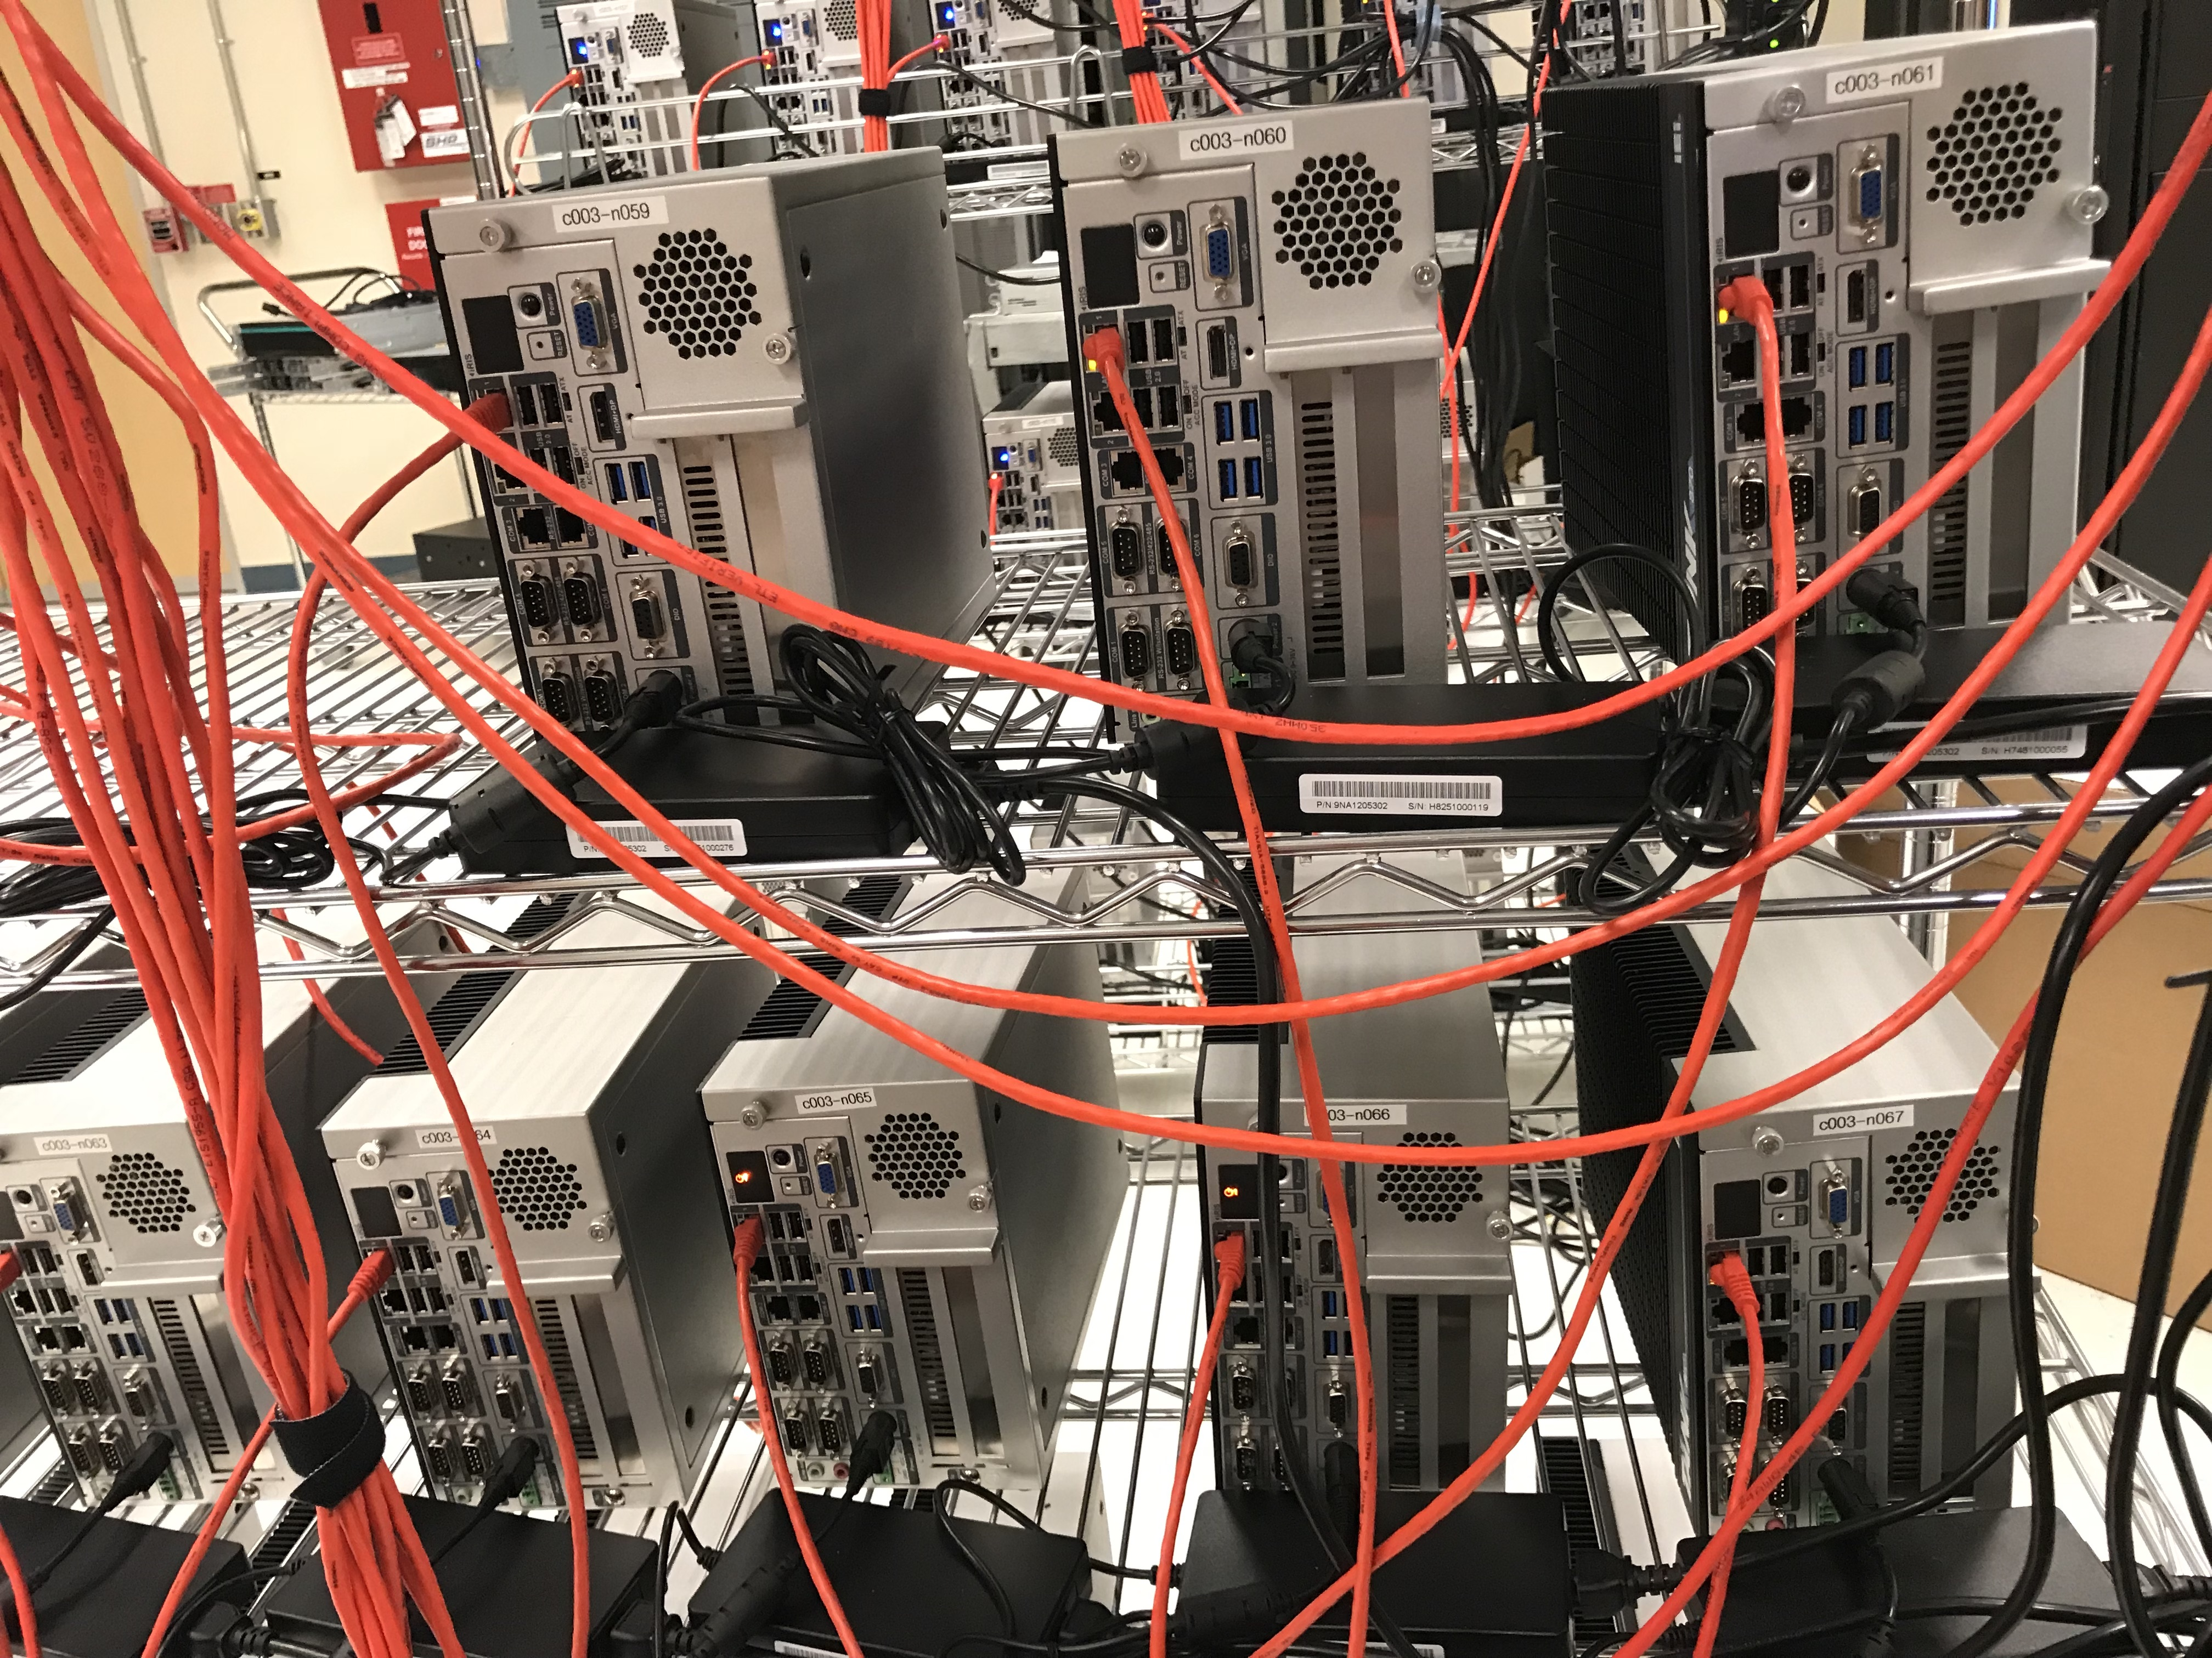
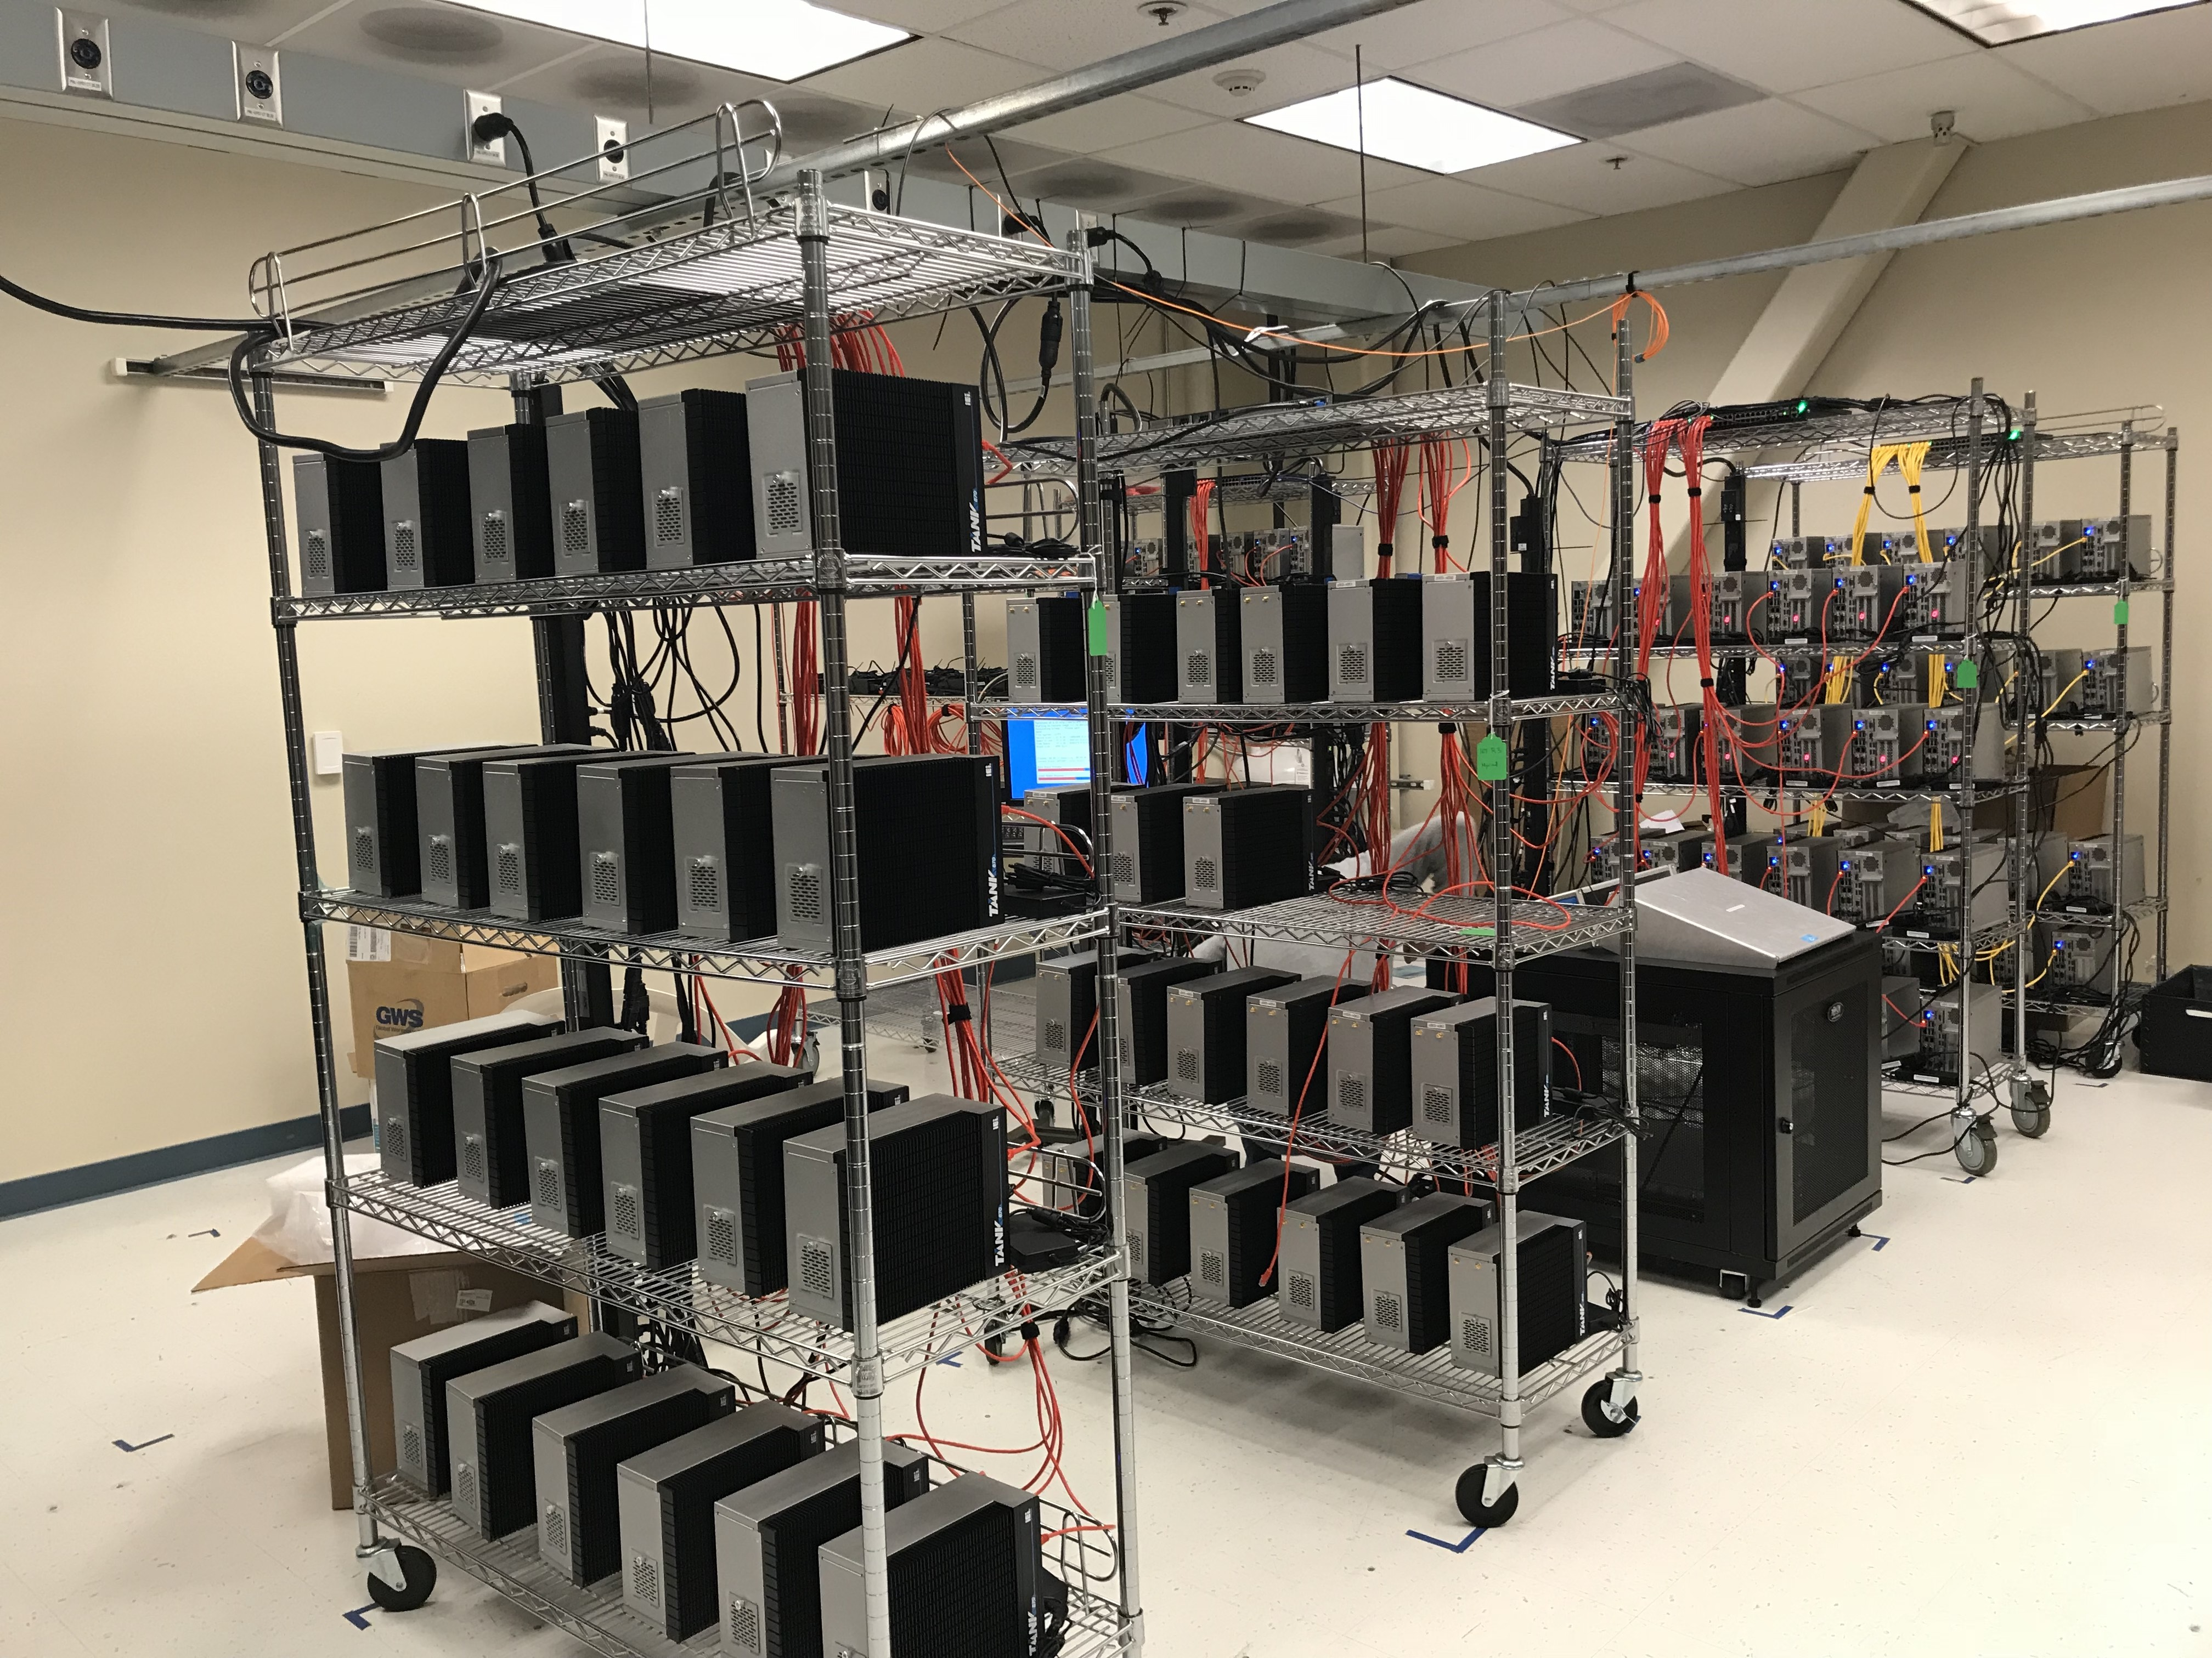



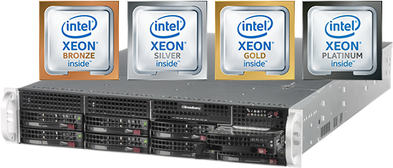





Intel IoT Developer Cloud
IOT DEVKITS, RRKS, OXM HARDWARE
Develop Using Jupyter Notebook
DEDICATED ACCESS
Terminal Access to Device
Choose Hardware(s) for Workload Compute/ Inference
(CPU/GPU, VPU, FPGA)
QUEUE
(H/W, S/W)
SCALABLE XEON BASED DEV SERVER
VISUALIZE OUTPUT
DYNAMIC STORAGE
Pre-installed s/w stacks (OS, SDK, Tools)
50G Dynamic storage allocated to all users
Metering, Profiling tools available to easily evaluate hardware
Examples to easily get started
LOGIN TO
IOT DEVCLOUD
Developer

Slide 39
AI: In Production registration
Signup for Access to the Intel® IoT DevCloud
Sign Up Here: https://colfaxresearch.com/iot-devcloud/ Intel’s Registration Passcode:
Code Valid From:
Code Valid To:
Account Activation:
Account Deactivation:
NY091140N74W
SEPT 10, 2019, 00:01 AM UTC
Sept 12, 2019, 11:59 PM UTC
Now
SEP 21, 2019, 11:59 PM UTC

Slide 40
Defect Detection Demo

Slide 41

Intel Edge Insights Software rapid deployment of analytics Pipelines
Industrial Solutions Division, Intel

Slide 42

Transformation in the Industrial market
Smart factory is one of the outcomes of Industry 4.0.
It employs artificial intelligence, robotics, analytics, workload consolidation, and IoT to transform raw data into immediate (near real-time) insights.
The benefits of smart factories are many¹:
Leaner process
Maximum flexibility
Improved predictability
Increased agility
Proven productivity
1. “Smart Factory and Its Benefits on Manufacturing Industry, ” Infinite Uptime August 21, 2018 https://infinite-uptime.com/blog/smart-factory-benefits-manufacturing/
Notes:
This is from article: https://infinite-uptime.com/blog/smart-factory-benefits-manufacturing/
Industry 4.0. technologies are helping manufacturers to digitize their factories. One of the most important of these technologies is Internet of Things (IoT). Powered by connectivity and sensors, it generates actionable, near real-time data insights about the condition of physical things in the factory and throughout the supply chain. This combined with data analytics, new technologies and a fast network is helping manufacturers better maintain their assets and boost efficiency in production.

Slide 43
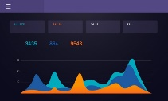



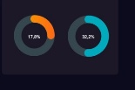
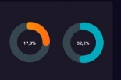
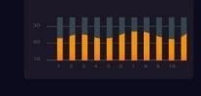
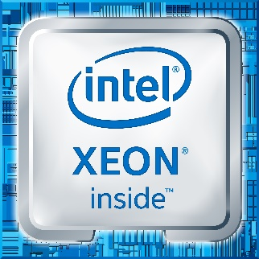

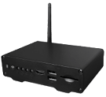
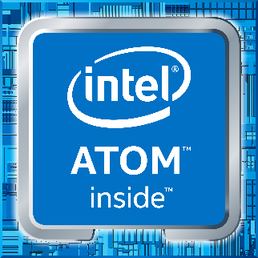




Analytics Pipelines for smart manufacturing
Local Dashboard/HMI
AI Training Cloud
Cloud-Based Dashboard
AI Training Edge
Scalable Edge Server
3rd Party Applications
Intel’s Algorithms
Industrial PC (CV/ML/DL)
OpenVINO™ Toolkit
Gateway (Time Series Data)
Intel’s Industrial Edge Insights Software
3rd Party Agents
Linux-based OS
Intel’s Algorithms
AI Inference Edge
3rd Party Agents
OpenVINO™ Toolkit
Intel’s Industrial Edge Insights Software
Intel’s Industrial Edge Insights Software
Linux*-based OS
Linux Based OS
* Other names and brands may be claimed as the property of others.
Notes:
Analytics pipelines are at the center of modern factories that leverage big data. The installation might be a gateway that is transiting time series data, or a scalable edge of server capturing video on the factory floor, or an industrial control system that is responsible for worker safety and product manufacturing. Having an rapidly, deployable infrastructure for analytics pipelines is key to factories of tomorrow.

Slide 44











Industrial Edge Insights Platform
Edge Insights Platform is both HW and SW designed to enable secure ingestion, processing, storage, orchestration and management of data, and near real-time (~10mS) event-driven control, across a diverse set of operating systems (OS) and industrial protocols.
Ingestion
Processing
Storage
Orchestration
Analytics
Edge Inference
Edge training
Secure data mgmt Access & control
SW: Edge Insights Software (EIS)
Ingestion
Processing
Storage
Orchestration
Management
Edge insights platform
HW: INTEL SILICON
cpus
accelerators
storage
connectivity
gpu
Real time
Other names and brands may be claimed as the property of others.
Notes:
Immediate (near real time) insights is a necessity for industrial end users to take effective decisions with respect to maintaining, monitoring, or optimizing industrial operations such as smart factories, smart buildings, smart grids, etc.
Edge based insights is the key to enabling/automating near real time decisions.
Intel offers an Industrial Edge Insights Platform:
It is a validated hardware and software for edge based insights that is designed to scale from Intel® Core™ solutions, to Intel® Xeon® E/D, to Intel® Xeon® SP on the edge. It supports Intel® VT and Intel® VT-x virtualization technologies, discrete/integrated TPM¹ and firmware TPM. It supports Intel’s CPU, GPU, FPGA, and VPU portfolio with hardware ranging from Gateways, Industrial PCs (IPCs), Edge Compute Nodes (ECNs), to Edge Servers.
The platform comes with a software stack that is designed to enable secure ingestion, processing, storage, orchestration and management of data, and near real-time (~10mS) event-driven control, across a diverse set of operating systems (OS) and industrial protocols. It provides connectors for easy usage of Intel® Media SDK, GStreamer, OpenVINO™ toolkit, and Intel® MKL. The software is $0 binary distribution (OBL) to intel’s ecosystem partners.

Slide 45
Intel industrial edge insights software
A software stack for rapid deployment of time series and video analytics
Product Vendors
It provides validated and tested smart manufacturing software ingredients for fast development and deployment and rapid time-to-market
It provides optimized video and time-series data ingestion and an analytics framework on a single platform that is validated and tested by Intel
It is a $0 license to use and distribute, which helps our partners to scale their business with minimum development investment
end users
Products with the software ingredients provide end users with incredible advanced insights and analytics to perform tasks such as:
Detecting defects using AI, ML, and DL
Performing predictive analytics
Enhancing their productivity and scale
Optimizing their industrial processes
Reducing maintenance and upkeep cost
Notes:
Both product vendors and users benefit from streamlined software stack.
Allowing product vendors to bring services and solutions to market faster.
And allowing and users to deploy analytics pipelines faster.

Slide 46



Industrial Edge insights Platform Use Cases
Defect Detection
Predictive analytics
Manufacturing Productivity
Package, part, or surface defects detection using AI and vision technology
Inline quality control/assurance
Reduce production losses and cost
Reduce customer returns
Predicting future outcomes based on historical data
Predict product quality
Predict equipment maintenance
Prevent costly maintenance
Predict yield fluctuation
Identifying opportunities/processes to improve on
Monitor and improve factory production efficiency
Monitor and identify production line constraints
Monitor worker safety
Applicable for brownfield and greenfield sites and infrastructures
Notes:
brownfield systems are systems that are already in existence that need to be upgraded so that their devices can communicate over the Network.
Greenfield systems are systems that are designed from the beginning to be computer network ready

Slide 47
TWO INGESTION PIPLINES: Video & Point Data
VIDEO Ingestion Services
ia_video_ingestion – this service is responsible for initializing the video input sources, which may be streaming RTSP sources (like a RTSP camera) or video files may be used as a source.
ia_imagestore – responsible for storing select frames of the video input
ia_video-analytics – responsible for performing inference or other types of analysis on the video frames
Point Data Ingestion
ia_telegraf – responsible for collecting point data and sending it to the database
ia_data_analytics – responsible for classifying the readings and sending alerts and monitoring to external applications

Slide 48




High-level view of industrial edge insights Platform
Intel IP
3rd-Party (SI, OxM, CSP, ISV)
Open Source
Data Management Service
Data Processing
Data Bus
(MQTT, OPC-UA, AMQP, NATS, DDS) *
Data agent service
(access/query/config)
Intel’s industrial edge insights software
User Defined Data Functions
(Kapacitor*)
Time Series Data Ingest/Egress with flexible Industrial protocol support
(Telegraf*)
Time Series DB (Influx DB*)
CV lib for Industrial
Data Visualization
(Chronograf*)
User Defined Event Driven Machine Control Service
Model Zoo for Industrial
Training
Video Data Ingestion with Video Decode
(Intel® Media SDK)
Image DB
(Redis/ MinIO) *
Data Bus Abstraction
OpenVINO™ toolkit
OS LAYER
OS LAYER
Linux*, AliOS* (Windows* supported)
Hypervisor
(KVM*, ACRN*)
Container Orchestration (Kubernetes*)
INTEL SILICON
CPUs
Accelerators
Storage
Connectivity
GPU
Real time
*Other names and brands may be claimed as the property of others.

Slide 49








Intel’s industrial edge insights software
Industrial Edge Insights Software is a product-quality software stack designed to enable secure ingestion, processing, storage, orchestration and management of data, and near real-time (~10mS) event-driven control, across a diverse set of operating systems (OS) and industrial protocols.
The software provides:
modular message/data bus for machine, video, and audio¹ workloads
containerized ingredients for image processing, storage, and analytics
support for industrial optimized inference and training¹ at the Edge
support for Windows*, Linux*, and AliOS*
multitenant microservices support for Azure*, Aliyun*, AWS¹ cloud connectors
connectors for easy usage of Intel® Media Software Development Kit (Intel® Media SDK), GStreamer, OpenVINO™ toolkit, and Intel® Math Kernel Library (Intel® MKL)
support for Intel’s CPU, GPU, FPGA, and VPU portfolio with hardware ranging from Gateways, Industrial PCs (IPCs), Edge Compute Nodes (ECNs), to Edge Servers
$0 binary distribution (OBL) to Intel’s ecosystem partners
security
Real time
AI
1- Available in future Industrial Edge Insights software releases *Other names and brands may be claimed as the property of others

Slide 50

Step 1a: Video ingestion
This module ingests video frames from a video source like video file or basler/RTSP/USB camera using gstreamer pipeline and publishes the (metadata, frame) tuple to the data bus.
Responsibilities of Video Ingestor
The Video Ingestion module starts capturing frames from Basler camera / RTSP camera (or video file) and sends the frames to the Trigger Algorithm.
Uses Trigger Functions to select Key Frames
Queues Key Frames to be published on the Data Bus
Triggers are defined by the application developer
./docker_setup/config/algo_config/factory_pcbdemo.json

Slide 51

Capturing Video from Camera or File sources
Step-1.a: The Video Ingestion module starts capturing frames from Basler camera / RTSP camera (or video file) and sends the frames to the Trigger Algorithm.

Slide 52
Step 1b: Point data ingestion
Point Data mode allows the ingestion of time series based like sensor readings that have a time stamp
Services in Point Data Mode
Telegraf is used to read multiple data formats and store them in InfluxDB
Uses Trigger Functions to select Key Frames
Queues Key Frames to be published on the Data Bus
Triggers are defined by the application developer
./docker_setup/config/algo_config/factory_pcbdemo.json

Slide 53

Step 2: Trigger Algorithm
The Trigger Algorithm will determine the relevant frames that are to go to the Classifier.
To create a custom trigger
Create a class derived from BaseTrigger
Override the constructor, __init__()
Enumerate the supported ingestors
Override the on_data() function, which is called when for each video frame.
Use OpenVINO or other libraries or methods to analyze the video and decide whether to pass it to the classifier or not.

Slide 54
Step 3: Kapacitor
Kapacitor subscribes to the Meta Data stream. All the streams in InfluxDB are subscribed as default by Kapacitor.
Kapacitor is configured by TICKscript
Kapacitor is an alert and monitoring system
Intel Edge Insights Software uses Kapacitor to subscribe to data coming into InfluxDB, passing it to a Classifier and then writing the results back to Influxdb.
This workflow is defined in a TICK script. Users and define their own TICK scripts.
The following handlers are currently supported:
Alerta: Sending alerts to Alerta.
Email: To send alerts by email.
HipChat: Sending alerts to the HipChat service.
Kafka: Sending alerts to an Apache Kafka cluster.
MQTT: Publishing alerts to an MQTT broker.
OpsGenie: Sending alerts to the OpsGenie service.
PagerDuty: Sending alerts to the PagerDuty service.
Pushover: Sending alerts to the Pushover service.
Sensu: Sending alerts to Sensu.
Slack: Sending alerts to Slack.
SNMP Trap: Posting to SNMP traps.
Talk: Sending alerts to the Talk service.
Telegram: Sending alerts to Telegram.
VictorOps: Sending alerts to the VictorOps service.

Slide 55
Step 4: Classifier
TICK Script
Defines the subscription of Kapacitor to InfluxDB
Kapacitor runs the classifier for each frame
Frame Classification results calculated
Kapacitor writes the results back to influxdb
The Classifier UDF (User Defined Function) receives the Meta Data from Kapacitor. It then invokes the UDF classifier algorithm.
The Classifier Algorithm is defined by the application developer.
OpenVINO is used for deep learning based visual inspection.
InfluxDB
1. Defines the subscription of Kapacitor to InfluxDB
2. Kapacitor runs the classifier for each frame
4. Kapacitor writes the results back to influxdb
Kapacitor
3. Frame Classification results calculated
Classifier

Slide 56
Step 10: Stream Manager
The Stream Manager subscribes to the Classified Results stream. The policy of stream export is set in the Stream Manager.
The data is published over OPC-UA to an external OPC-UA server and can be integrated into the existing environment and 3rd party applications.
InfluxDB
Stream Manager subscribes to the classifier results
Stream Manager
OPC-UA to External Applications

Slide 57
Image Store and Data Agent
Image Store
Redis - in-memory data structure store, used as a database, cache and message broker
Minio - Open Source, Enterprise-Grade, Amazon S3 Compatible Object Storage
Data Agent
Responsible for initializing the stream manager to listen to the data going into InfluxDB
Runs a gRPC server for connection to the ImageStore

Slide 58
Step 12: Result Published to External Applications
The Classified result is published in the OPC-UA message bus and available to external applications

Slide 59

Visualize the data with chronograf
Chronograf lets you visualize the results of a query to the time series database.
Measurements can be grouped by intervals, single point data, or data over time.

Slide 60





JWIPC RRK: edge insights RFP ready kit
AI-Ready AIO Gateways/Industrial PCs
Intel’s Industrial Edge Insights Software
Intel® OpenVINO™ toolkit
* and Link Edge* Ready
Intel® Atom™, Intel® Core™, Intel® Xeon™ Processors
Fan or Fanless, Rugged Configurations
2-4x PCIe* (Altera® or Intel® Movidius™ technology)
2-4x COM 6x USB3.0
2.5”HDD Hot Plug
2-4x Ethernet (PoE)
Ubuntu*, CentOS*, Windows*, or Yocto* Ready¹
1- OpenVINO™ Toolkit OS Support: CentOS* 7.4 (64 bit), Ubuntu* 16.04.3 LTS (64 bit), Microsoft Windows* 10 (64 bit), Yocto Project* version Poky Jethro v2.0.3 (64 bit)
* Other names and brands may be claimed as the property of others.
Notes:
Comes bundled with Intel Edge insight software

Slide 61

IEI Tank-870-Q170
PCIe slots that will support HDDL-F (FPGA) and HDDL-RC (Myriad X)
Core i5
Fanless
8GB of RAM
1TB HDD
2x PCIe x8
Dual LAN with TSN support
WIFI
I/O Ports: 4x USB 3.0, 4 x USB 2.0, 4x RS-232, 2x RS-232/485, 8-bit DIO, 1x Line-out, 1x Mic-in
Operating Temp: -20°C~60°C
The IOT Client Foundational Kit will provide manageability, performance, and a scalable rapid path to market solution that will support advanced computer vision and deep learning usages.
http://eshop.usa.ieiworld.com/usa/items.php?CA=2&sub_CA=24
https://software.intel.com/en-us/blogs/2018/06/13/introducing-the-tank-aiot-developer-kit
Notes:
The IEI tank comes as an official Intel developer zone development kit

Slide 62

Vision Acceleration Kit + HDDL-R
Powered by IEI*
Specialized Processors designed for high-performance machine vision at low power
8 VPUs x 16 SHAVE cores (Streaming Hybrid Architecture Vector Engine)
Supports multiple network topologies (GoogLeNet, ResNet, etc.)
Two Memory Banks (DDR4, 8GB in total)
Preinstalled Intel® Distribution of OpenVINO™ toolkit
Get started quickly with samples
TANK-870-Q170

Slide 63
IEI* Tank AIOT Developer Kit
High-performance computer vision Applications
Industrialized Design
Intel® Core™ or Intel® Xeon™ Spec.
Extendible with PCIe* AI Accelerators
Preloaded with the Intel® Distribution of OpenVINO™ toolkit

Slide 64












Intel ingredients in Industrial Automation
Data Center | Compute Performance I/O intensive
Factory server | Compute Performance I/O intensive
Industrial PC | Compute Performance Visualization/ UX RT Perf
PLC/PAC | I/O intensive Form Factor Sensitive RT Perf
HMI | Compute Performance Visualization/ UX Form Factor Sensitive
Remote IO | I/O intensive RT Perf
Robots | Compute Performance I/O intensive RT Perf
Machine visions | Compute Performance Form Factor Sensitive
Mobile workforce | Visualization/ UX Form Factor Sensitive

Slide 65











Verified swappable IPC ready to run
ADLINK TECHNOLOGY, INC
PRODUCTS: RK-630/IMB-M43-C236 RK-630/IMB-M43H
LEARN MORE: https://www.adlinktech.com/
IBASE TECHNOLOGY INC. PRODUCTS: CMI203-991 AMI222 LEARN MORE: https://www.ibase.com.tw/
IEI INTEGRATION CORP. PRODUCTS: TANK-870AI TANK-870e-H110 LEARN MORE: https://www.ieiworld.com/
ARBOR
PRODUCTS: FPC-7903
LEARN MORE: https://www.arbor-technology.com/
LEX COMPUTECH CO., LTD.
PRODUCTS: CI170A
LEARN MORE: http://www.lex.com.tw/
AXIOMTEK CO., LTD
PRODUCTS: IPC962-511-FL IPC962-512-FL
LEARN MORE: http://www.axiomtek.com/
NEXCOM INTERNATIONAL CO., LTD
PRODUCTS: NIFE300P2E LEARN MORE: http://www.nexcom.com/
DFI INC.
PRODUCTS: KU173 SD631
LEARN MORE: http://www.dfi.com/
QUANMAX INC.
PRODUCTS: RAK-400 LEARN MORE: http://www.quanmax.com/
Photo source: Intel® IoT Solutions Alliance Solution Directory
Notes:
These product slides show some of the latest IPC products. You may use part, all or just one in your customer discussion.
This slide shows IPCs that have been ‘validated’ to work on a legacy migration where the legacy OS remains. On slide #20 it would be the option on the right.
More devices are being added to this valided list.

Slide 66

Migrate to a New Industrial PC Today
Avoid Obsolescence, Improve Security and Be Prepared for the Future

Slide 67
Restricted Zone Notifier

Slide 68
Intel Final Slide

